Slide 1


Software-Defined Hardware Without Sacrificing Performance
Matthew Feldman
Department of Electrical Engineering
PhD Dissertation Defense
June 14, 2018
Slides: https://tinyurl.com/yafqu5km

Slide 2
Introduction
The transition from instruction-based architectures to custom hardware

Slide 3
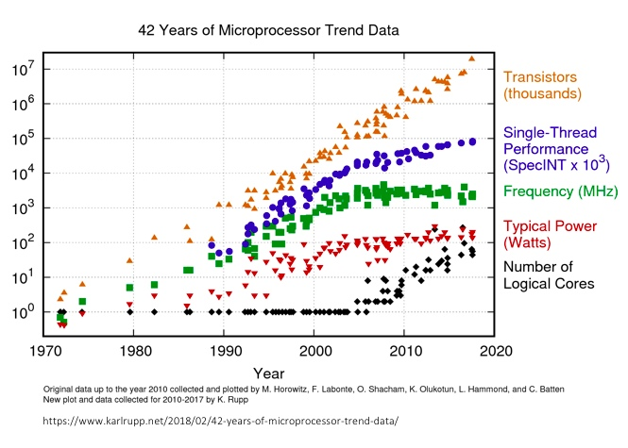
The CPU Power Wall
Packing more transistors onto a chip will no longer work because of limits on power delivery and heat dissipation.

Slide 4
Where Does All The Energy Go?
Instruction-Based
CPU
Floating Point
70 pJ
Control
Arithmetic/Logic
Inst. Queue
Register File
25pJ
6pJ
38pJ
L1 Cache (Instructions)
L1 Cache
(Data)
I-cache access
Register File
Access
Control Overheads
32-bit ADD: ~0.5 pJ
L2 Cache
Mark Horowitz, Computing’s Energy Problem (and what we can do about it) ISSCC 2014
DRAM
Legend
Control
Compute
*Not to scale
SRAM
Regs
TODO: Redo slides or can I credit David or whoever made them?

Slide 5
Hardware to the Rescue
Instruction-Based
CPU*
Custom Hardware*
mov r8, rcx add r8, 8 mov r9, rdx add r9, 8 mov rcx, rax mov rax, 0 .calc: mov rbx, [r9]
imul rbx, [r8] add rax, rbx add r8, 8 add r9, 8 loop .calc
ctrl
Floating Point
Control
ctr
vectorA
Arithmetic/Logic
×
+
acc
vectorB
Inst. Queue
Register File
+
L1 Cache (Instructions)
L1 Cache
(Data)
DRAM
L2 Cache
*Also not to scale
DRAM
Legend
Control
Compute
*Not to scale
SRAM
Regs
TODO: Redo slides or can I credit David or whoever made them?

Slide 6
Performance and Power
Energy
efficiency
Performance
$$Power=\frac{Ops}{second}×\frac{Joules}{Op}$$
FIXED
What is the magnitude of improvement from specialization?
Specialization (fixed function) ⇒ better energy efficiency
Notes:
hitting the so called power wall, means power is expected to stay constant, while performance is still expected to increase. This can only be achieved by reducing the power per op, so performance is no longer measured in terms of Flops but in terms of Flop/watt.

Slide 7
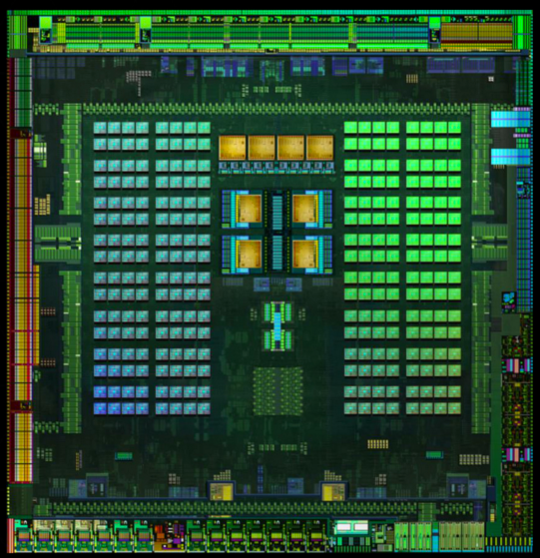


Compute Devices at a Glance
ASIC
Throughput-Oriented Device
GPU
Programmable Logic
FPGA
Energy-optimized CPU
Application-Specific
Integrated Circuit (ASIC)
Programmable DSP
Least efficient
Specialization is the key
Most efficient
Easiest to program
Hardest to program
Not programmable
Least expensive
Most expensive
We are going to focus here
Credit: CS149

Slide 8
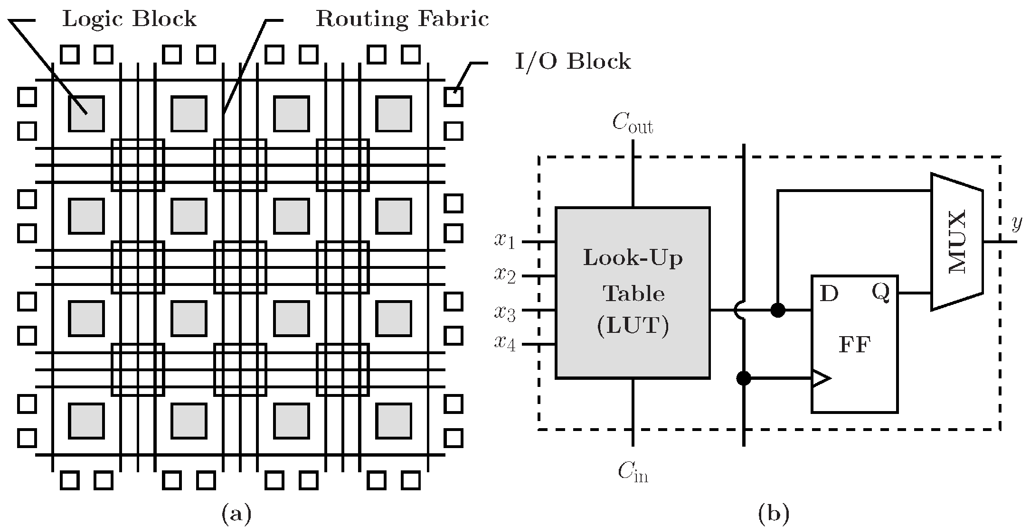
FPGA Crash Course
Field-programmable gate array
Reconfigurable logic device consisting of
On-chip Memory (BRAMs) - ~10s Mb
Logic Cells (LUTs + FFs) - ~1M
Processing blocks (DSPs) - ~1000s

Slide 9
Hardware Platforms
Field programmable gate array (FPGA)
…
Application-specific integrated circuit (ASIC)
Pros: Fast clock, low power
Cons: Expensive and slow to manufacture, not programmable
Coarse-grain reconfigurable architecture (CGRA)
Pros: Fast clock, somewhat reconfigurable
Cons: …

Slide 10


Hardware will have a big role in the near future
Add CGRAs?
10,000
Dedicated
ASIC
Brainwave (ISCA ’18)
1,000
39.5 TFLOPs
287 MOps/mW
Stratix 10 w/ ms-fp8
Reconfigurable
100
Energy Efficiency (MOPS/mW)
FPGA
Instruction-Based
GPU
10
XPU (HotChips ’17)
CPU
1
64x perf vs. CPU
25x perf/W vs. CPU
0.1
Not programmable
Less programmable
More programmable
Programmability

Slide 11








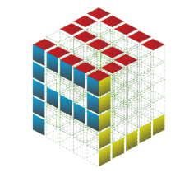













Domain
Specificity
Domain-Specific
Halide
Multi-Domain
Verilog
MyHDL
x86
Netlist
VHDL
General Purpose
Abstraction
Abstraction
Lower Level
Higher Level
Lower Level
“How?”
“What?”
“How?”
Reconfigurable Architectures (FPGAs)
Instruction-Based Architectures (CPUs)

Slide 12
A lot of area devoted to hard gates
Memory blocks (SRAM)
DSP blocks (multiplier)

Slide 13
FPGA Crash Course

Slide 14
You want to design an accelerator for your next algorithm…
Which language should you use? ^{[1]}
[1] N. Kapre et al, "Survey of domain-specific languages for FPGA computing,” FPL 2016

Slide 15
Choosing a Language
Do you want optimal performance for any general algorithm?
Go master a hardware description language (HDL), such as Verilog^{[6]} or VHDL^{[7]}
Or use a slightly more user-friendly alternative like, Chisel^{[1]}, Bluespec^{[2]}, PyMTL^{[3]}, MaxJ^{[4]}, and SystemVerilog^{[5]}
[1] https://people.eecs.berkeley.edu/~krste/papers/chisel-dac2012.pdf
[2] https://www.ece.ucsb.edu/its/bluespec/index.html
[3] https://www.csl.cornell.edu/pymtl2019/
[4] https://www.maxeler.com/products/software/maxcompiler/
[5] https://www.doulos.com/knowhow/sysverilog/tutorial/
[6] https://www.verilog.com/
[7] https://www.ics.uci.edu/~jmoorkan/vhdlref/Synario%20VHDL%20Manual.pdf

Slide 16
Choosing a Language
Do you want optimal performance for a specific domain?
For image processing, use Aetherling^{[9]}/Halide^{[10]}
For machine learning, use LeFlow^{[11]} or DNNWeaver^{[12]}
For signal processing, use Spiral^{[13]}
For networking, use SNORT^{[14]}
[9] https://aetherling.org/
[10] https://halide-lang.org/
[11] https://arxiv.org/abs/1807.05317
[12] http://dnnweaver.org/
[13] https://www.spiral.net/hardware/dftgen.html
[14] https://pdfs.semanticscholar.org/7972/1de4ed6848c1c581270e365dddc84bd8c06f.pdf

Slide 17
Choosing a Language
Do you want mediocre performance for any general algorithm?
If you like C/C++ and pragmas, use OpenCL^{[15]}, Vivado HLS^{[16]}, or SDAccel^{[17]}
(TODO: Too insulting?) If you like programming but wish it felt more like making macaroni art, use LabVIEW FPGA^{[18]}
If you like Java, use Liquid Metal (Lime)^{[19]} or Spatial^{[20]}
Disclaimer: The rest of the talk is going to be about optimizations and tools for getting better performance at this level of abstraction, and Spatial is going to be the vehicle for the story
[15] https://www.khronos.org/opencl/
[16] https://www.xilinx.com/products/design-tools/vivado/integration/esl-design.html
[17] https://www.xilinx.com/products/design-tools/software-zone/sdaccel.html
[18] https://www.ni.com/en-us/shop/select/labview-fpga-module
[19] https://researcher.watson.ibm.com/researcher/view_group.php?id=122
[20] https://spatial-lang.org

Slide 18
Choosing a Language
Key question: What needs to be done to place Spatial here?
High Performance
VHDL
Domain Specific
Verilog
Halide
Spiral
LeFlow
DNNWeaver
Mission
accomplished?
Spatial
Liquid Metal (Lime)
“Easiness” / Productivity / Lines of Code

Slide 19
Hardware Design At a Glance
To create a good accelerator, the designer must optimize computation and memory accesses in order to keep all parts of the circuit active at all times
In order to do this, the designer can make decisions about
Parallelism - Run operations concurrently
Data Locality - Manually manage on-chip scratchpads
Control Flow - Orchestrate how loops execute relative to each other

Slide 20
Key Contributions in This Talk
Problem: Expressing hardware at a high level results in sub-optimal designs
Solution: Design a language and compiler that provides
the right software abstractions
A performance debugging environment that lends itself to a set of optimization principles
Hardware-oriented optimizations for memory partitioning
Validation: Demonstrate effectiveness on a real-world problem

Slide 21
Choosing a Language, at a glance
High Performance
VHDL
Verilog
Halide
Spiral
LeFlow
DNNWeaver
Blackbox support allows you to use Spatial’s optimizations
on top of custom modules imported from another framework.
TODO: Mention black boxing at all?
“Easiness” / Productivity / Lines of Code

Slide 22
Bridging the Gap
The key to achieving high performance at a high level of abstraction is intuitive performance profiling and targeted compiler optimizations.

Slide 23
Principles of hardware design
What do hardware designers think about?

Slide 24
Software-Defined Hardware
The programmer partitions code into “Host” (i.e. CPU) and “Accelerator” (i.e. FPGA)
FPGA
Host
Accelerator
Def main(args: Seq[String]): Void = {
// Host Code
Accel{
// Accel Code
}
// More Host Code
}

Slide 25
Software-Defined Hardware
The programmer partitions code into “Host” (i.e. CPU) and “Accelerator” (i.e. FPGA)
Communication hardware is automatically instantiated
FPGA
Host
Regfile
Accelerator
DRAM
DMA
(Direct Memory Access)

Slide 26
Principles of Hardware Design
Designing a good accelerator comes to two concepts
Balancing pipeline stages
Optimizing dataflow circuits
There are three tools at the designer’s disposal:
Parallelism - Run operations concurrently
Data Locality - Manually manage on-chip scratchpads
Control Flow - Orchestrate how loops execute relative to each other
Since software is an awkward way to express hardware, how does the programmer know exactly where to apply these tools to design a better accelerator?

Slide 27
Parallelism
Parallelism comes in two forms in hardware:
Spatial parallelism - Widen the circuit to accept more inputs per cycle
Pipeline parallelism - Insert pipeline registers through the circuit to accept later iterations before earlier iterations complete
Iter 0
Op
Op
Iter 1
Op
Op
Op
Op
Iter 0
Iter 1
Iter 0
Op
Op
Iter 1
Iter 2
Iter 0
Op
Op
Iter 1
Iter 2

Slide 28
Data Locality
Data must reside in one of two places:
Remote - Visible to the host and the accelerator
Local - Visible to the accelerator only
FPGA
Host
Regfile
Accelerator
SRAM
TODO: Cleaner
srams and regs
SRAM
DRAM
DMA
SRAM

Slide 29
Data Locality
Data must be manually placed in a resource:
DRAM - off-chip, burst-addressable
SRAM - on-chip, word-addressable
Register - on-chip, single word
Slower
Faster
Larger (GB)
Smaller (KB)
DDR DRAM
On-Chip SRAM
Local Regs

Slide 30
Control Flow
Contracts regarding how loops should execute relative to each other.
Example:
Pre-fetching
Streaming
TODO: These animations are a little janky
Compute
DRAM
SRAM
Compute
DRAM
SRAM

Slide 31
The Right Abstractions for SDH

Slide 32
Parallel Patterns
Parallel patterns are loop abstractions with implicit information about parallelism and access patterns
X0
X1
X2
X3
X0
X1
X2
X3
X0
X1
X2
X3
Z0
Z1
Z2
Z3
f
f
f
f
f
f
f
f
f
f
f
Y0
Y1
Y2
Y3
Y0
Y1
Y2
Y3
Y
Map
Element-wise function f
Reduce
Combine elements with
(associative) function f
Zip
Element-wise combine function f
Spatial is an imperative language that is designed to easily capture parallel patterns^{[2]}
[2] R. Prabhakar et al. “Generating Configurable Hardware from Parallel Patterns.” ASPLOS 2016

Slide 33
Parallel Patterns
More complex operations can be built from parallel patterns.
X0
X1
X2
X3
X4
X0
X1
X2
X3
X4
g
g
g
g
g
g
g
g
TODO: Drop this slide?
f
f
f
f
f
f
f
Scalar Accumulation
Produce elements with function g, accumulate with (associative) function f
Array Accumulation
Produce collection with function g, zip-accumulate with function f
Y0
Y1
Y2
Y3
f
Y
Fold(Y)(N by 1 par P) { i =>
g(x(i))
} {(a,b) => f(a,b)}
MemReduce(Y)(N by 1 par P2) { i =>
g(x(i))
} {(a,b) => f(a,b)}

Slide 34
Loops and Memories
How the software pieces fit together to create hardware

Slide 35
How Loops Map to Hardware
A software “loop” is counter chain + controller
Counter chain - Collection of iterators that are chained together
Controller - A container for a data path or other controllers
Controllers are nested:
Inner - contains datapaths of only primitive nodes
Outer - contains only other controllers (called “children”)
Foreach(N by 1) { i => // Outer controller
Foreach(M by 1) { j => mem(i,j) = i+j } // Inner controller
Foreach(P by 1) { j => if (j == 0) … = mem(i,j) } // Inner controller
}
}

Slide 36
How Loops Map to Hardware
Language Notes
TODO: Drop this slide?
Shorthand for “0 until N by 1”
Iterator for loop is labelled “i”
Foreach(N by 1) { i => // Outer controller
Foreach(M by 1) { j => mem(i,j) = i+j } // Inner controller
Foreach(P by 1) { j => if (j == 0) … = mem(i,j) } // Inner controller
}
}

Slide 37
How Arrays Map to Hardware
Each “array” is manually placed on a resource:
DRAM - off-chip, burst-addressable
SRAM - on-chip, word-addressable
Register - on-chip, single word
Larger (GB)
Smaller (KB)
Slower
Faster
DDR DRAM
On-Chip SRAM
Local Regs

Slide 38
How Arrays Map to Hardware
Language Notes
TODO: Drop this slide?
DRAM malloc of type T. Size resolved at runtime (args(0))
SRAM of size 32 elements of type T
Register of Int type, initialized to 2
Def main(args: Seq[Int]): Void = {
Val d = DRAM[T](args(0))
Accel {
Val s = SRAM[T](32)
Val r = Reg[Int](2)
}
}

Slide 39
Key Contributions in This Talk
Problem: Expressing hardware at a high level results in sub-optimal designs
Solution: Design a language and compiler that provides
the right software abstractions
A performance debugging environment that lends itself to a set of optimization principles
Hardware-oriented optimizations for memory partitioning
Validation: Demonstrate effectiveness on a real-world problem

Slide 40
A Deep Dive Into Performance

Slide 41
Performance Analysis
The runtime of a controller (T) depends on its latency (L), initiation interval (II), and number of iterations (iters)
Enable signal received from parent
Done signal sent to parent
L = 7 cycs
Foreach(5 by 1) {i =>
… // L = 7, II = 2
}
Time
i = 0
i = 1
Abstract Example
i = 2
II = 2 cycs
i = 3
Key Equation:
$$T=II⋅(iters-1)+L$$
i = 4
$T=2⋅(5-1)+7=15$ cycs
Iteration
($±3$ for communication overhead)

Slide 42
Understanding Performance
The performance equation
$$T=II⋅(iters-1)+L$$
T = Total cycles (per iteration of parent)
II = initiation interval (interval between counter “steps”)
iters = total iterations (number of “steps” in controller’s counter-chain)
L = body latency (interval between counter incrementing and last node finishing)

Slide 43
Understanding Performance
The performance equation
$$T=II⋅(iters-1)+L$$
T = Total cycles (per iteration of parent)
II = initiation interval (interval between counter “steps”)
iters = total iterations (number of “steps” in controller’s counter-chain)
L = body latency (interval between counter incrementing and last node finishing)
II and L take slightly different meanings for inner vs outer controllers

Slide 44
Performance Analysis
Initiation Interval (II) and Latency (L) can be tricky to nail down.
For inner controllers, II and L are static and computed at compile-time based on the structure of the datapath
Foreach(5 by 1) {i =>
… // L = 7, II = 2
}
Key Equation:
$$T=II⋅(iters-1)+L$$
For outer controllers, we must approximate them based on the schedule of the controller

Slide 45
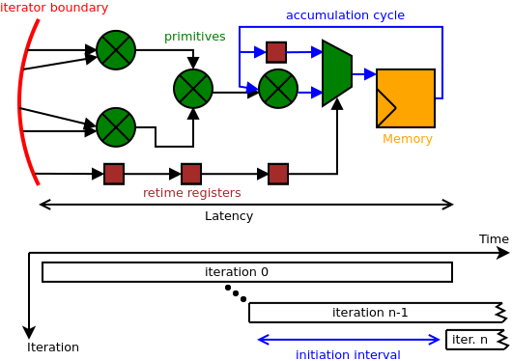
Performance Analysis - Inner Controller
$T=II⋅(iters-1)+L$
L and II are computed at compile-time
Foreach(N by 1, M by 1, P by 1, Q by 1){(i,j,p,q) =>
val sum = i + j + p + q
val next = reg.value ^ sum
reg := mux(q == 0, reg.value, next)
}

Slide 46
Performance Analysis - Outer Controller
The performance equation for an outer controller
$T=II_{eff}⋅(iters-1)+L_{eff}$
IIeff - “effective” initiation interval
Leff - “effective” latency
Why “effective?” We must first understand controller schedules

Slide 47
Outer Controller Scheduling
Outer controller schedules are:
Sequential - No overlapping of child controllers
Pipelined - Coarse-grained overlapping of child controllers
Stream - Data-driven execution of child controllers
Fork-Join - Parallel execution of all child controllers
Fork - Selective execution of one child per-iteration

Slide 48
A Closer Look at Schedules
Time
Sequential.Foreach(…){i =>
sram load dram
Foreach(M by 1){ j => sram2(j) = sram(j) * j }
dram store sram2
}
Load
i = 0
i = 1
Foreach
i = 0
i = 1
Store
i = 0
Stage
Effective Latency and II
Note: Foreach with no annotation is implicitly “Pipelined”
Time
Pipelined.Foreach(…){i =>
sram load dram
Foreach(M by 1){ j => sram2(j) = sram(j) * j }
dram2 store sram2
}
Load
i = 0
i = 1
i = 2
i = 3
Foreach
i = 0
i = 1
i = 2
Store
i = 0
i = 1
Stage
Effective Latency
Effective II
Time
Stream.Foreach(…){i =>
fifoIn load dram
Foreach(M by 1){ j => fifoOut.enq(fifoIn.deq() * j) }
dram2 store fifoOut
}
Load
i = 0
i = 1
i = 2
i = 3
i = 4
Foreach
i = 0
i = 1
i = 2
i = 3
Store
i = 0
i = 1
i = 2
i = 3
Stage
Effective Latency
Effective II

Slide 49
A Closer Look at Schedules
Time
Sequential.Foreach(…){i =>
sram load dram
Foreach(M by 1){ j => sram2(j) = sram(j) * j }
dram store sram2
}
Load
i = 0
i = 1
Foreach
i = 0
i = 1
When the pipeline is full, it is in steady-state and the longest stage determines II
Store
i = 0
Stage
Effective Latency and II
Note: Foreach with no annotation is implicitly “Pipelined”
Time
Pipelined.Foreach(…){i =>
sram load dram
Foreach(M by 1){ j => sram2(j) = sram(j) * j }
dram2 store sram2
}
Load
i = 0
i = 1
i = 2
i = 3
Foreach
i = 0
i = 1
i = 2
Store
i = 0
i = 1
When an intermediate FIFO is full, the producer stage is stalled.
Stage
Effective Latency
Effective II
Time
Stream.Foreach(…){i =>
fifoIn load dram
Foreach(M by 1){ j => fifoOut.enq(fifoIn.deq() * j) }
dram2 store fifoOut
}
Load
i = 0
i = 1
i = 2
i = 3
i = 4
Foreach
i = 0
i = 1
i = 2
i = 3
When an intermediate FIFO is empty, the consumer stage is starved.
Store
i = 0
i = 1
i = 2
i = 3
Stage
Effective Latency
Effective II

Slide 50
A Closer Look at Schedules
Time
ForkJoin(N by 1){ i =>
sram load dram
sram2 load dram2
sram3 load dram3
}
Load 1
i = 0
i = 1
Load 2
i = 0
i = 1
Load 3
i = 0
i = 1
Stage
Effective Latency and II
Time
Fork(N by 1){ i =>
if (cond == 1) => sram load dram
else if (cond == 2) => sram2 load dram2
else sram3 load dram3
}
Load 1
i = 1
i = 2
Load 2
i = 0
Load 3
i = 3
Stage
4x Effective Latency and II

Slide 51
Understanding the Hierarchy

Slide 52
Piecing the Hierarchy Together
Consider the slice of a loop nesting with a parent Sequential Controller and three children.
Sequential.Foreach(Q by TS){ i =>
Foreach(N by 1){ j => /* Primitives */ }
Foreach(M by 1){ j => /* Controllers */ }
Stream.Foreach(P by 1) { j => /* Controllers */ }
}
Time
Inner Foreach
i = 0
i = 1
Outer Foreach
i = 0
i = 1
Stream Foreach
i = 0
Stage
Time
i = 0
Time
Time
i = 1
Child0
i = 0
i = 1
i = 2
i = 3
i = 4
i = 1
Child0
i = 0
i = 1
i = 2
i = 3
i = 2
Child1
i = 0
i = 1
i = 2
i = 3
Child1
i = 0
i = 1
i = 2
Iteration
Child2
i = 0
i = 1
i = 2
i = 3
Child2
i = 0
i = 1
Stage
Stage

Slide 53
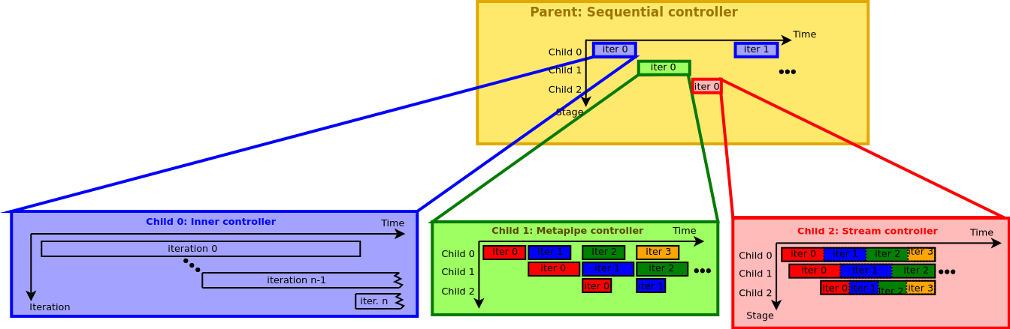
Piecing the Hierarchy Together
In the context of our equation…
$$T=II_{eff}⋅(iters-1)+L_{eff}$$
Sequential.Foreach(Q by TS){ i =>
Foreach(N by 1){ j => /* Primitives */ }
Pipe.Foreach(M by 1){ j => /* Controllers */ }
Stream.Foreach(P by 1) { j => /* Controllers */ }
}

Slide 54
Piecing the Hierarchy Together
In the context of our equation…
$$iters=\frac{Q}{TS}$$
$$T=II_{eff}⋅(iters-1)+L_{eff}$$
Sequential.Foreach(Q by TS){ i =>
Foreach(N by 1){ j => /* Primitives */ }
Pipe.Foreach(M by 1){ j => /* Controllers */ }
Stream.Foreach(P by 1) { j => /* Controllers */ }
}

Slide 55
Piecing the Hierarchy Together
In the context of our equation…
$$T=II_{eff}⋅(iters-1)+L_{eff}$$
Sequential.Foreach(Q by TS){ i =>
Foreach(N by 1){ j => /* Primitives */ }
Pipe.Foreach(M by 1){ j => /* Controllers */ }
Stream.Foreach(P by 1) { j => /* Controllers */ }
}
$$L_{eff}=II_{eff}=∑T_{child}$$

Slide 56
Key Contribution
Thinking about performance this way quickly becomes very messy.
Controller hierarchy diagrams are they key to achieving better performance
Generated and annotated automatically by Spatial
Convey detailed information about performance and resource utilization

Slide 57
Controller Hierarchy Diagrams
Controller hierarchy diagrams distill the app into a human-readable structure
Sequential.Foreach(Q by TS){ i =>
Foreach(N by 1){ j => /* Primitives */ }
Foreach(M by 1){ j => /* Controllers */ }
Stream.Foreach(P by 1) { j => /* Controllers */ }
}
Sequential (i)
[:1]
Inner (j)
[:2] ii=#, L=#
Pipelined (j)
[:3]
Stream (j)
[:4]
Line numbers link back to source code
Initiation interval and latency of inner controllers

Slide 58
Controller Hierarchy Diagrams
Controller hierarchy diagrams distill the app into a human-readable structure
Stream dependencies and stall/starve counts embedded
Child
T=#, iters=#
stalled=#
Child
T=#, iters=#
starved=#
Sequential.Foreach(Q by TS){ i =>
Foreach(N by 1){ j => /* Primitives */ }
Foreach(M by 1){ j => /* Controllers */ }
Stream.Foreach(P by 1) { j => /* Controllers */ }
}
FIFO
Sequential (i)
[:1]
T=#, iters=#
KEY:
Black text - Compile-time property
Red text - Run-time property
Inner (j)
[:2] ii=#, L=#
T=#, iters=#
Pipelined (j)
[:3]
T=#, iters=#
Stream (j)
[:4]
T=#, iters=#
Line numbers link back to source code
Initiation interval and latency of inner controllers
T and iteration counts automatically injected after running application

Slide 59
Connecting the Diagram to Waveforms
Sequential (i)
[:1]
T=#, iters=#
T measures duration of one execution
Inner (j)
[:2] ii=#, L=#
T=#, iters=#
Pipelined (j)
[:3]
T=#, iters=#
Stream (j)
[:4]
T=#, iters=#
Iters measures number of executions
Time
Inner Foreach
Outer Foreach
Stream Foreach
Stage
i = 1
Child0
Child0
Child1
Child1
Child2
Child2

Slide 60
Design Concepts Captured by Hierarchy Diagrams

Slide 61
Load/Store Subtrees
Spatial has shorthand syntax for transferring tiles of data to/from DRAM
Foreach(…){ i =>
sram load dram(i::i+T+1)
dram2(i::i+T) store sram2
}
Pipelined (i)
[:1]
Stream
[:2]
Stream
[:3]
Unit
[implicit]
CMD GEN
Unit
[implicit]
Unit
[implicit]
CMD GEN
Unit
[implicit]
DATA TX
Unit
[implicit]
ACK RX
Unit
[implicit]
CMD RX
Unit
[implicit]
DATA RX
DRAM

Slide 62
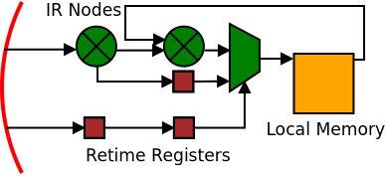
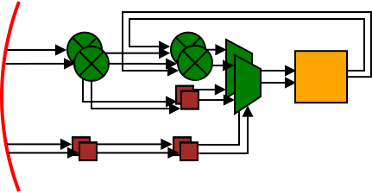
Debugging Performance
There is an important distinction between Inner and Outer controller parallelization
Inner controller parallelization results in straightforward data path vectorization
TODO: Delete this slide?
Foreach(N by 1 par 1){ i => ... }
Foreach(N by 1 par 2){ i => ... }
Increase parallelization

Slide 63
Parallelization
There is an important distinction between Inner and Outer controller parallelization
Inner controller parallelization results in a vectorized datapath (i.e. SIMD parallelism)
Outer controller parallelization results in controller replication

Slide 64
Outer Controller Parallelization
Simply duplicating controllers does not fully exploit the parallelism
Foreach(N by 1 par 2){ i =>
Foreach(…) {…}
Foreach(…) {…}
}
Pipelined (i)
[:1]
Pipelined (j)
[:2]
Pipelined (j)
[:2]
Pipelined (j)
[:3]
Pipelined (j)
[:3]
even i
odd i
even i
odd i
Pipelined (i)
[:1]
Pipelined (j)
[:2]
Pipelined (j)
[:3]
(Unparallelized Structure)

Slide 65
Outer Controller Parallelization
Simply duplicating controllers does not fully exploit the parallelism
Parallelism can be captured as either a: Pipeline of ForkJoins (PoF)
Foreach(N by 1 par 2){ i =>
Foreach(…) {…}
Foreach(…) {…}
}
Pipelined (i)
[:1]
Pipelined (j)
[:2]
ForkJoin
[implicit]
Pipelined (j)
[:2]
ForkJoin
[implicit]
Pipelined (j)
[:3]
Pipelined (j)
[:3]
Pipelined (i)
[:1]
even i
odd i
even i
odd i
Pipelined (j)
[:2]
Pipelined (j)
[:3]
(Unparallelized Structure)

Slide 66
Outer Controller Parallelization
Simply duplicating controllers does not fully exploit the parallelism
Parallelism can be captured as either a: Pipeline of ForkJoins (PoF) or a ForkJoin of Pipelines (FoP)
Foreach(N by 1 par 2){ i =>
Foreach(…) {…}
Foreach(…) {…}
}
Pipelined (i)
[:1]
Pipelined (i)
[:1]
ForkJoin
[implicit]
ForkJoin
[implicit]
Pipelined (i)
[:1]
Pipelined (j)
[:2]
Pipelined (j)
[:2]
Pipelined (j)
[:3]
Pipelined (j)
[:3]
even i
even i
odd i
odd i
Pipelined (j)
[:2]
Pipelined (j)
[:3]
(Unparallelized Structure)

Slide 67
Resource Utilization
Buffering is implicit duplication of a memory to protect accesses from each other in a Pipelined controller
Necessary for correctness but can eat up a lot of resources if the programmer is not careful!

Slide 68
Debugging Resource Utilization
Consider a three-stage pipeline that writes to a memory in the first stage and reads from it in the third…
j=0
j=1
j=2
Pipe.Foreach(M by 1){ j =>
val s = SRAM[T](256)
Foreach(N by 1){k => s(k) = …}
Foreach(N by 1){k => …}
Foreach(N by 1){k => … = s(k)}
}
j=0
S
j=1
No-access
j=2
Data written during j=0 is already gone
TODO: Cut this slide out?

Slide 69
Resource Utilization
Buffering is implicit duplication of a memory to protect accesses from each other in a Pipelined controller
The compiler computes buffering automatically
i=0
i=3
i=1
N-Buffer
Foreach(M by 1){ i =>
val s = SRAM[T](256)
Foreach(N by 1){k => s(k) = …}
Foreach(N by 1){k => …}
Foreach(N by 1){k => … = s(k)}
}
i=4
i=2
S
i=1
i=2
i=3
i=0
i=3 data
No-access
i=0 data
i=0
S
i=4 data
i=1
i=1 data
i=2
S
i=2 data

Slide 70
Resource Utilization
Buffering is embedded in the controller hierarchy diagram.
The SRAM requires 3 separate 256-word memories, plus buffer management logic!
Foreach(M by 1){ j =>
val s = SRAM[T](256)
Foreach(N by 1){k => s(k) = …}
Foreach(N by 1){k => …}
Foreach(N by 1){k => … = s(k)}
}
Pipelined (j)
[:1]
s [:2]
Child
[:3]
Child
[:4]
Child
[:5]

Slide 71
Principled Approach to Program Optimization
The steps and how the controller hierarchy diagrams help

Slide 72
Using Controller Diagrams
We will take a principled approach to optimization with 4 steps:
Assess the bottleneck
Modify the hierarchy
Increase DMA efficiency
Tweak scheduling

Slide 73
Example
Suppose someone wrote this snippet. Let’s apply the procedure to see how terribly the code actually maps to hardware…
Foreach(4096 by 64 par 1){ i =>
val x = SRAM[T](64)
x load dram(i::i+64)
val tmp = x(i/64)/7
Foreach(128 by 1 par 1){j => y(j) = x(j/2) / tmp}
}
Pipeline (i)
[:1]
Load
[:3]
Unit
[:4]
Inner (j)
[:5] L=17,II=1

Slide 74
Bottleneck Analysis
1) Assess the bottleneck
Needs more par
Foreach(4096 by 64 par 1){ i =>
val x = SRAM[T](64)
x load dram(i::i+64)
val tmp = x(i/64)/7
Foreach(128 by 1 par 1){j => y(j) = x(j/2) / tmp}
}
Identify bottleneck*
Pipeline (i)
[:1]
T=9640, iters=1
Load
[:3]
T=84, iters=64
starved=18
Unit
[:4]
T=18, iters=64
Inner (j)
[:5] L=20,II=1
T=149, iters=64
* Bottleneck here is significant because 3-stage pipeline runs for 64 iterations, meaning it is in steady-state for a while

Slide 75
Bottleneck Analysis
1) Assess the bottleneck
Needs more par
Runtime cut from 9640 to 5543
Foreach(4096 by 64 par 1){ i =>
val x = SRAM[T](64)
x load dram(i::i+64)
val tmp = x(i/64)/7
Foreach(128 by 1 par 2){j => y(j) = x(j/2) / tmp}
}
Not a significant bottleneck now ($84≈85$)
Pipeline (i)
[:1]
T=5543, iters=1
Load
[:2]
T=84, iters=64
starved=18
Unit
[:4]
T=18, iters=64
Inner (j)
[:4] L=20,II=1
T=85, iters=64

Slide 76
Bottleneck Analysis
2) Adjust the hierarchy
Code can be restructured to eliminate stage by computing this in inner controller
Foreach(4096 by 64 par 1){ i =>
val x = SRAM[T](64)
x load dram(i::i+64)
val tmp = x(i/64)/7
Foreach(128 by 1 par 2){j => y(j) = x(j/2) / tmp}
}
Pipeline (i)
[:1]
T=5543, iters=1
Is triple-buffer necessary?
x [:2]
Load
[:3]
T=84, iters=64
starved=18
Unit
[:4]
T=18, iters=64
Inner (j)
[:5] L=20,II=1
T=85, iters=64

Slide 77
Bottleneck Analysis
2) Adjust the hierarchy
Foreach(4096 by 64 par 1){ i =>
val x = SRAM[T](64)
x load dram(i::i+64)
Foreach(128 by 1 par 2){j =>
y(j) = x(j/2) / (x(i/64) / 7)
}
}
Tiny reduction in runtime (5543 -> 5524)
Pipeline (i)
[:1]
T=5524, iters=1
Reduced to double buffer
x [:2]
Load
[:3]
T=84, iters=64
starved=18
Inner (j)
[:4] L=20,II=1
T=85, iters=64
Note this change is “free” in hardware the divide-by-7 circuitry is stamped out either way, and its latency can be hidden by the existing latency of the inner controller

Slide 78
Bottleneck Analysis
3) Maximize DMA efficiency
Foreach(4096 by 64 par 1){ i =>
val x = SRAM[T](64)
x load dram(i::i+64)
Foreach(128 by 1 par 2){j =>
y(j) = x(j/2) / (x(i/64) / 7)
}
}
Pipeline (i)
[:1]
T=5524, iters=1
x [:2]
DRAM
Load
[:3]
T=84, iters=64
starved=18
Inner (j)
[:4] L=20,II=1
T=85, iters=64
DMA
Increasing DMA performance means keeping it as busy as possible.

Slide 79
Bottleneck Analysis
3) Maximize DMA efficiency
Foreach(4096 by 64 par 1){ i =>
val x = SRAM[T](64)
x load dram(i::i+64)
Foreach(128 by 1 par 2){j =>
y(j) = x(j/2) / (x(i/64) / 7)
}
}
Let’s focus on increasing parallelization…
Pipeline (i)
[:1]
T=5524, iters=1
x [:2]
Load
[:3]
T=84, iters=64
starved=18
Inner (j)
[:4] L=20,II=1
T=85, iters=64
DRAM
DMA

Slide 80
Bottleneck Analysis
3) Maximize DMA efficiency
Foreach(4096 by 64 par P){ i =>
val x = SRAM[T](64)
x load dram(i::i+64)
Foreach(128 by 1 par 2){j =>
y(j) = x(j/2) / (x(i/64) / 7)
}
}
Let’s focus on increasing parallelization…
Pipeline (i)
[:1]
T=5524, iters=1
x0 [:2]
x1 [:2]
x2 [:2]
ForkJoin
[implicit]
T=#, iters=64/P
ForkJoin
[implicit]
T=87, iters=64/P
DRAM
Load
[:2]
T=84, iters=64
starved=18
Inner (j)
[:4] L=20,II=1
T=85, iters=64
Load
[:2]
T=84, iters=64
starved=18
Inner (j)
[:4] L=20,II=1
T=85, iters=64
Load
[:3]
T=#, iters=64/P
starved=[more]
Inner (j)
[:4] L=20,II=1
T=85, iters=64/P
DMA

Slide 81
Bottleneck Analysis
3) Maximize DMA efficiency
The goal is to construct a controller tree whose links to the DMA keep the link(s) to DRAM saturated.
DRAM
DMA

Slide 82
Bottleneck Analysis
3) Maximize DMA efficiency
Foreach(4096 by 64 par P){ i =>
val x = SRAM[T](64)
x load dram(i::i+64)
Foreach(128 by 1 par 2){j =>
y(j) = x(j/2) / (x(i/64) / 7)
}
}
Pipeline (i)
[:1]
T=#, iters=1
Your controller tree is DRAM-bound when the speedup due to iters reduction is cancelled by the increase in starved-cycles due to congestion
x0 [:2]
x1 [:2]
x2 [:2]
ForkJoin
[implicit]
T=#, iters=64/P
ForkJoin
[implicit]
T=87, iters=64/P
DRAM
Load
[:2]
T=84, iters=64
starved=18
Inner (j)
[:4] L=20,II=1
T=85, iters=64
Load
[:2]
T=84, iters=64
starved=18
Inner (j)
[:4] L=20,II=1
T=85, iters=64
Load
[:3]
T=#, iters=64/P
starved=[more]
Inner (j)
[:4] L=20,II=1
T=85, iters=64/P
DMA

Slide 83
Bottleneck Analysis
Rewriting the parent as a Stream controller could help cut resource utilization and runtime
4) Tweak scheduling
Foreach(4096 by 64 par P){ i =>
val x = SRAM[T](64)
x load dram(i::i+64)
Foreach(128 by 1 par 2){j =>
y(j) = x(j/2) / (x(i/64) / 7)
}
}
Pipeline (i)
[:1]
T=#, iters=1
x0 [:2]
x1 [:2]
x2 [:2]
ForkJoin
[implicit]
T=#, iters=64/P
ForkJoin
[implicit]
T=87, iters=64/P
DRAM
Load
[:2]
T=84, iters=64
starved=18
Inner (j)
[:4] L=20,II=1
T=85, iters=64
Load
[:2]
T=84, iters=64
starved=18
Inner (j)
[:4] L=20,II=1
T=85, iters=64
Load
[:3]
T=#, iters=64/P
starved=[more]
Inner (j)
[:4] L=20,II=1
T=85, iters=64/P
DMA

Slide 84
Bottleneck Analysis
Rewriting the parent as a Stream controller could help cut resource utilization and runtime
4) Tweak scheduling
Stream.Foreach(4096 by 64 par P){ i =>
val x = FIFO[T](4)
x load dram(i::i+64)
Foreach(128 by 1 par 2){j =>
val num = mux(j%2 == 0, x.deq(), x.peek())
if (i % 64 == 0) reg := x.peek()
y.enq(num / (reg / 7))
}
}
Pipeline (i)
[:1]
T=#, iters=1
ForkJoin
[implicit]
T=#, iters=64/P
ForkJoin
[implicit]
T=#, iters=64/P
This requires some effort by the programmer
DRAM
Load
[:2]
T=84, iters=64
starved=18
Inner (j)
[:4] L=20,II=1
T=85, iters=64
y [:?]
Load
[:2]
T=84, iters=64
starved=18
Inner (j)
[:4] L=20,II=1
T=85, iters=64
Load
[:3]
T=#, iters=64/P
starved=[more]
Stalled=#
Inner (j)
[:4] L=20,II=1
T=#, iters=64/P
starved=#
DMA
x2 [:2]
x1 [:2]
x0 [:2]

Slide 85
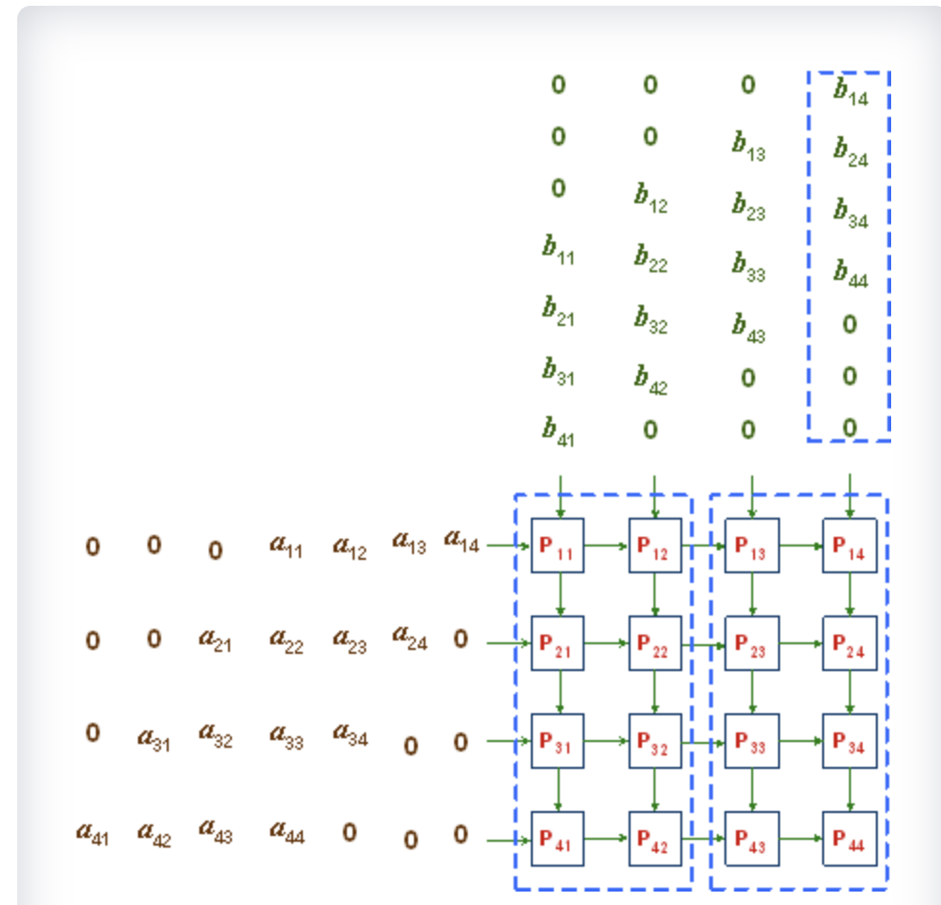
Systolic Array

Slide 86
val C = SRAM[T](outerTile, outerTile)
Stream.Foreach(M by outerTile, N by outerTile, P by innerTile) { (ii, jj, kk) =>
val A_fifos = List.tabulate(outerTile){i => FIFO[T](innerTile)}
val B_fifos = List.tabulate(outerTile){i => FIFO[T](innerTile)}
// Load FIFOs
A_fifos.zipWithIndex.foreach{case (f,i) => if (ii + i < M) f load a(ii + i,kk::kk+innerTile )}
B_fifos.zipWithIndex.foreach{case (f,j) => if (jj + j < N) f load b(jj + j,kk::kk+innerTile )}
// Drain FIFOs and compute
val A_sr = RegFile[T](outerTile, outerTile)
val B_sr = RegFile[T](outerTile, outerTile)
val computeDone = FIFO[Int](8)
Pipe {
val C_acc = SRAM[T](outerTile, outerTile)
Foreach(innerTile + outerTile*2 - 1 by 1) { k =>
Parallel {
def deqOr0(f: FIFO[T], lineId: scala.Int, shiftId: Int): T = {
if (shiftId >= lineId && shiftId < lineId + innerTile) f.deq() else 0.to[T]
}
A_fifos.zipWithIndex.foreach { case (f, i) => Pipe{A_sr(i, *) <<= deqOr0(f, i, k) }}
B_fifos.zipWithIndex.foreach { case (f, j) => Pipe{B_sr(*, j) <<= deqOr0(f, j, k) }}
}
Pipe.II(1).Foreach(outerTile by 1 par redPar, outerTile by 1) { (i, j) =>
val A = mux(k >= i + j, A_sr(i, j), 0.to[T])
val B = mux(k >= i + j, B_sr(i, j), 0.to[T])
val update = A * B + mux(k > i + j || kk != 0, C_acc(i, j), 0.to[T])
C_acc(i, j) = update
if (kk == P - innerTile && k == innerTile + outerTile*2 - 2) C(i, j) = update
}
}
computeDone.enq(mux(kk == P - innerTile, 1, 0))
}
// Store
Pipe{
if (computeDone.deq() == 1) c(ii::ii+outerTile, jj::jj+outerTile) store C
}

Slide 87
Tiny Performance Example

Slide 88
Bottleneck Analysis
Now that we understand controller trees and inner controller parallelization, let’s look at a quick example
Foreach(512 by 64){ i =>
x load dram(i::i+64)
Val tmp = x(i)/7
Foreach(192 by 1 par 1) {j => y((j+i)%192) = tmp}
}
Sequential (i)
[:1]
Load
[:2]
Unit
[implicit]
Inner (j)
[:4] L=17,II=1

Slide 89
Bottleneck Analysis
Now that we understand controller trees and inner controller parallelization, let’s look at a quick example
Minimize parent runtime
Foreach(512 by 64){ i =>
x load dram(i::i+64)
Val tmp = x(i)/7
Foreach(192 by 1 par 1) {j => y((j+i)%192) = tmp}
}
Identify bottleneck*
Pipeline (i)
[:1]
T=1576, iters=1
Load
[:2]
T=81, iters=8
Unit
[implicit]
T=25, iters=8
Inner (j)
[:4] L=17,II=1
T=210, iters=8
* Relative importance of the bottleneck stage increases with the number of iterations the parent is in steady state

Slide 90
Bottleneck Analysis
Now that we understand controller trees and inner controller parallelization, let’s look at a quick example
Foreach(512 by 64){ i =>
x load dram(i::i+64)
Val tmp = x(i)/7
Foreach(192 by 1 par 3) {j => y((j+i)%192) = tmp}
}
Identify bottleneck*
Sequential (i)
[:1]
T=680, iters=1
Load
[:2]
T=81, iters=8
Unit
[implicit]
T=25, iters=8
Inner (j)
[:4] L=17,II=1
T=82, iters=8
* Relative importance of the bottleneck stage increases with the number of iterations the parent is in steady state

Slide 91
Bottleneck Analysis
Now that we understand controller trees and inner controller parallelization, let’s look at a quick example
Foreach(512 by 64){ i =>
x load dram(i::i+64)
Val tmp = x(i)/7
Foreach(192 by 1 par 1) {j => y((j+i)%192) = tmp}
}
Identify bottleneck*
Tweak tree structure†
Sequential (i)
[:1]
T=680, iters=1
Load
[:2]
T=81, iters=8
Unit
[implicit]
T=25, iters=8
Inner (j)
[:4] L=17,II=1
T=82, iters=8
* Relative importance of the bottleneck stage increases with the number of iterations the parent is in steady state
† Relative importance of tiny stages decreases with the number of iterations parent is in steady state, but is important for saving resources (we will discuss this soon)

Slide 92
Bottleneck Analysis
Now that we understand controller trees and inner controller parallelization, let’s look at a quick example
Foreach(512 by 64){ i =>
x load dram(i::i+64)
Foreach(192 by 1 par 1) {j =>
y((j+i)%192) = x(i)/7
}
}
Sequential (i)
[:1]
T=662, iters=1
Load
[:2]
T=81, iters=8
Inner (j)
[:4] L=18,II=1
T=83, iters=8
T went from 1576 to 662

Slide 93
Advanced Performance Example

Slide 94
Advanced Bottleneck Analysis
Performance debugging is not always so nice and clean though.
Imagine an app where you must apply a (dynamic) blur kernel to a vector repeatedly, N-times
N-Blur
64 words
x
…
sr
(ShiftIn, Read)
1 cyc
k0
k1
k2
(mul)
L = 21 cyc
6 cyc
II = 1 cyc
D
(sum)
2 cyc
(normalize)
12 cyc

Slide 95
Advanced Bottleneck Analysis
Performance debugging is not always so nice and clean though.
Imagine an app where you must apply a (dynamic) blur kernel to a vector repeatedly, N-times
N-Blur
64 words
x
…
L = 21 cyc
II = 1 cyc
Repeat N times

Slide 96
Bottleneck Analysis II Example
N-Blur
64 words
x
…
L = 21 cyc
Speed up bottleneck (parallelize)
II = 1 cyc
Identify bottleneck
Foreach(N by 1) {i =>
Val odd = i % 2 == 1
Val (k0,k1,k2) = mux(odd == 0, (2,4,2), (8,4,4))
Val D = k0 + k1 + k2
Foreach(64 by 1 par 1){ j =>
Sr <<= x(j)
Val tmp = (x(0)*k0 + x(1)*k1 + x(2)*k2) / D
x(j) = tmp
}
}
Pipeline (i)
[:1]
T=38891, iters=1
Unit
[implicit] L=10,II=*
T=10, iters=96
Inner (j)
[:5] L=21,II=1
T=405, iters=96

Slide 97
Bottleneck Analysis II Example
N-Blur
64 words
x
…
L = 21 cyc
Speed up bottleneck (parallelize)
II = 1 cyc
T went from 38891 to 20459
Foreach(N by 1) {i =>
Val odd = i % 2 == 1
Val (k0,k1,k2) = mux(odd == 0, (2,4,2), (8,4,4))
Val D = k0 + k1 + k2
Foreach(64 by 1 par 2){ j =>
Sr <<= x(j)
Val tmp = (x(0)*k0 + x(1)*k1 + x(2)*k2) / D
x(j) = tmp
}
}
Pipeline (i)
[:1]
T=20459, iters=1
Let’s parallelize more!
Unit
[implicit] L=10,II=*
T=10, iters=96
Inner (j)
[:5] L=21,II=1
T=212, iters=96

Slide 98
Bottleneck Analysis II Example
N-Blur
64 words
II increased because iteration distance between identical addresses (16) became smaller than the cycle† latency (21)
x
…
L = 21 cyc
Speed up bottleneck (parallelize)
II = 2 cyc
T went from 20459 to 20267
Pipeline (i)
[:1]
T=20267, iters=1
Foreach(N by 1) {i =>
Val odd = i % 2 == 1
Val (k0,k1,k2) = mux(odd == 0, (2,4,2), (8,4,4))
Val D = k0 + k1 + k2
Foreach(64 by 1 par 4){ j =>
Sr <<= x(j)
Val tmp = (x(0)*k0 + x(1)*k1 + x(2)*k2) / D
x(j) = tmp
}
}
Unit
[implicit] L=10,II=*
T=10, iters=96
Inner (j)
[:5] L=21,II=2
T=211, iters=96
† In this example, the entire body is a cycle.

Slide 99
Bottleneck Analysis II Example
N-Blur
64 words
x
…
Par 2 (or 3) seems to be the best we can do…
…Unless if we can use some programmer intuition to cut back on the latency!
L = 21 cyc
II = 1 cyc
Foreach(N by 1) {i =>
Val odd = i % 2 == 1
Val (k0,k1,k2) = mux(odd == 0, (2,4,2), (8,4,4))
Val D = k0 + k1 + k2
Foreach(64 by 1 par 1){ j =>
Sr <<= x(j)
Val tmp = (x(0)*k0 + x(1)*k1 + x(2)*k2) / D
x(j) = tmp
}
}
Pipeline (i)
[:1]
T=20459, iters=1
Unit
[implicit] L=10,II=*
T=10, iters=96
Inner (j)
[:5] L=21,II=1
T=212, iters=96

Slide 100
Bottleneck Analysis II Example
N-Blur
64 words
x
…
Mult and Div by arbitrary operands have large latencies
sr
(ShiftIn, Read)
1 cyc
k0
k1
k2
(mul)
6 cyc
(sum)
2 cyc
… But we know that the operands are always power-of-2. We can do these ops “for free” in hardware if we are clever about this!
D
(normalize)
12 cyc
Foreach(N by 1) {i =>
Val odd = i % 2 == 1
Val (k0,k1,k2) = mux(odd == 0, (2,4,2), (8,4,4))
Val D = k0 + k1 + k2
Foreach(64 by 1 par 1){ j =>
Sr <<= x(j)
Val tmp = (x(0)*k0 + x(1)*k1 + x(2)*k2) / D
x(j) = tmp
}
}
Pipeline (i)
[:1]
T=20459, iters=1
Unit
[implicit] L=10,II=*
T=10, iters=96
Inner (j)
[:5] L=21,II=1
T=212, iters=96

Slide 101
Bottleneck Analysis II Example
N-Blur
64 words
x
…
We bought a modest speedup with this change (20459 -> 18723).
sr
(ShiftIn, Read)
1 cyc
But more importantly, we increased our capacity for parallelization by reducing the latency of the accumulation loop!
(shift)
0 cyc
(sum)
2 cyc
(shift)
0 cyc
Compute both blurs in the inner controller, and then select one using a mux.
(mux)
1 cyc
Foreach(N by 1) {i =>
Val odd = i % 2 == 1
Foreach(64 by 1 par 2){ j =>
Sr <<= x(j)
val tmp = mux(odd,
(x(0)<<1 + x(1)<<2 + x(2)<<1) >> 3,
(x(0)<<3 + x(1)<<2 + x(2)<<2) >> 4,
x(j) = tmp
}
}
Pipeline (i)
[:1]
T=18273, iters=1
Unit
[implicit] L=10,II=*
T=8, iters=96
Inner (j)
[:3] L=4,II=1
T=196, iters=96
This would be a dumb change in software but is smart in SDH

Slide 102
Bottleneck Analysis II Example
N-Blur
64 words
x
…
But more importantly, we increased our capacity for parallelization by reducing the latency of the accumulation loop!
L = 4 cyc
II = 1 cyc
Foreach(N by 1) {i =>
Val odd = i % 2 == 1
Foreach(64 by 1 par 16){ j =>
Sr <<= x(j)
val tmp = mux(odd,
(x(0)<<1 + x(1)<<2 + x(2)<<1) >> 3,
(x(0)<<3 + x(1)<<2 + x(2)<<2) >> 4,
x(j) = tmp
}
}
T went from 18273 to 2787
Pipeline (i)
[:1]
T=2787, iters=1
Is this the best we can do?
Unit
[implicit] L=8,II=*
T=8, iters=96
Inner (j)
[:3] L=4,II=1
T=29, iters=96

Slide 103
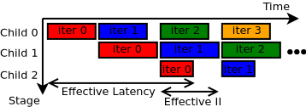
Bottleneck Analysis II Example
N-Blur
64 words
x
…
Assuming 64 is not a tunable tile-size, par 16 seems to be the best we can do.
Inspect hierarchy
L = 4 cyc
II = 1 cyc
Estimate Leff and IIeff of parent…
Leff=32, IIeff=29
Foreach(N by 1) {i =>
Val odd = i % 2 == 1
Foreach(64 by 1 par 16){ j =>
Sr <<= x(j)
val tmp = mux(odd,
(x(0)<<1 + x(1)<<2 + x(2)<<1) >> 3,
(x(0)<<3 + x(1)<<2 + x(2)<<2) >> 4,
x(j) = tmp
}
}
Pipeline (i)
[:1]
T=2787, iters=1
Can we flatten the hierarchy?
Unit
[implicit] L=8,II=*
T=8, iters=96
Inner (j)
[:3], L=4,II=1
T=29, iters=96
IIeff of the parent is large because the runtime of the longest child became the IIeff!

Slide 104
Bottleneck Analysis II Example
Fuse loops and compute odd each iteration. This adds a small amount of latency but is not part of the accumulation cycle
Foreach(N by 1, 64 by 1 par 16) {(i,j) =>
val odd = x % 2 == 1
val tmp = mux(odd,
(x(0)<<1 + x(1)<<2 + x(2)<<1) >> 3,
(x(0)<<3 + x(1)<<2 + x(2)<<2) >> 4,
x(j) = tmp
}
Pipeline (x,j)
[:1] L=21,II=1
T=2325, iters=1
T went from 2787 to 2325 (plus this will save resources, as we will discuss later)

Slide 105
DRAM-Bound Analysis Example

Slide 106
DRAM-Bound Analysis
An important question in SDH is whether your app is DRAM-bound
One way to check is to compare the data in/out of your app to the theoretical peak bandwidth of the chip, but
Not all DRAM transactions are capable of achieving peak (i.e. small requests, commands that are not burst aligned, etc.)
Certain parts of the app may be bigger hotspots for DRAM than others

Slide 107
DRAM-Bound Analysis
Controller diagrams are the key
Consider this sample app
Pipelined (i)
[:1]
Foreach(96 by 1 par 1){ i =>
Sram load dram(i*16::(i+1)*16)
Foreach(*) {…}
}
Load
[:2]
Pipelined (j)
[:3]
DRAM
DMA

Slide 108
DRAM-Bound Analysis
An important question in SDH is whether your app is DRAM-bound
Controller diagrams hold the key to answering this question
Consider this sample app
Pipelined (i)
[:1]
*PoF Unrolling
Foreach(96 by 1 par P){ i =>
Sram load dram(i*16::(i+1)*16)
Foreach(*) {…}
}
ForkJoin
[implicit]
ForkJoin
[implicit]
Load
[:2]
Pipelined (j)
[:3]
Load
[:2]
Pipelined (j)
[:3]
…
…
DRAM
…
DMA
Congestion!

Slide 109
DRAM-Bound Analysis
If you have constructed a controller tree whose links to the DMA keep the link(s) to DRAM saturated, your job is done.
DRAM
…
DMA

Slide 110
DRAM-Bound Criteria
Bottleneck: Load/Store controllers are bottlenecks
Activity: The stall rate is larger* than the marginal burden
Stall Rate - $\frac{cycs_{idle}}{cycs_{active}+cycs_{idle}}$ - Percent of time a controller spends doing real work
$Δ$Burden - The percent change in data other controllers must bear, given the addition of the controller in question
* We assume steady state and persistent congestion for the controller sub-tree in question, and tolerate a little bit of overhead

Slide 112
DRAM-Bound Applications
Is this DRAM-Bound?
Foreach(96 by 1 par 1){ i =>
Sram load dram(i*16::(i+1)*16)
Foreach(*) {…}
}
Bottleneck
(ish)
Activity (SR>$Δ$B)
(There is always some overhead. This controller doesn’t seem to be cramped just yet)
Pipelined (i)
[:1]
T=46591, iters=1
Load
[:2]
T=480,iters=96
starved=20
Pipelined (j)
[:3]
T=475,iters=96
No, keep working
$Δ$B=1.0
Stall-Rate=0.04

Slide 113
DRAM-Bound Applications
Is this DRAM-Bound?
Foreach(96 by 1 par 2){ i =>
Sram load dram(i*16::(i+1)*16)
Foreach(*) {…}
}
Bottleneck
Activity (SR>$Δ$B)
Pipelined (i)
[:1]
T=23566, iters=1
No, keep working
ForkJoin
[implicit]
T=481, iters=48
ForkJoin
[implicit]
T=478, iters=48
Load
[:2]
T=488,iters=48
starved=28
Load
[:2]
T=487,iters=48
starved=27
Pipelined (j)
[:3]
T=475,iters=48
Pipelined (j)
[:3]
T=475,iters=48
(Parallelizing by 2 doubles the resources and cuts runtime to ~50.5% [23566 / 46591].)
$Δ$B=0.5
Stall-Rate=0.05

Slide 114
DRAM-Bound Applications
Is this DRAM-Bound?
Foreach(96 by 1 par 3){ i =>
Sram load dram(i*16::(i+1)*16)
Foreach(*) {…}
}
Bottleneck
Activity (SR>$Δ$B)
Pipelined (i)
[:1]
T=17534, iters=1
No, but proceed with caution
ForkJoin
[implicit]
T=518, iters=32
ForkJoin
[implicit]
T=478, iters=32
Load
[:2]
T=530,iters=32
starved=50
Load
[:2]
T=527,iters=32
starved=47
Pipelined (j)
[:3]
T=475,iters=32
Pipelined (j)
[:3]
T=475,iters=32
…
…
(Parallelizing by 3 triples the resources but only cut runtime to ~38% [17534 / 46591] because of increased congestion)
$Δ$B=0.17
Stall-Rate=0.094

Slide 115
DRAM-Bound Applications
Is this DRAM-Bound?
Foreach(96 by 1 par 4){ i =>
Sram load dram(i*16::(i+1)*16)
Foreach(*) {…}
}
Bottleneck
Activity (SR>$Δ$B)
Pipelined (i)
[:1]
T=14014, iters=1
Yes! Please stop
ForkJoin
[implicit]
T=564, iters=24
ForkJoin
[implicit]
T=478, iters=24
Load
[:2]
T=561,iters=24
starved=81
Load
[:2]
T=559,iters=24
starved=79
Pipelined (j)
[:3]
T=475,iters=24
Pipelined (j)
[:3]
T=475,iters=24
…
…
(Parallelizing by 4 quadruples the resources but only cut runtime to ~29% [14014 / 46591] because of increased congestion)
$Δ$B=0.08
Stall-Rate=0.14

Slide 116
Tiny Buffering Example

Slide 117
Controller Diagrams for Performance Analysis
Buffering is also embedded in the controller diagram
Pipe.Foreach(M by 1){ j =>
val s = SRAM[T](256)
Foreach(N by 1){k => s(k) = …}
Foreach(N by 1){k => …}
Foreach(N by 1){k => … = s(k)}
}
The SRAM requires 3 separate 256-word memories, plus buffer management logic!
Pipelined (j)
[:1]
s [:2]
Child
[:3]
Child
[:4]
Child
[:5]

Slide 118
Controller Diagrams for Performance Analysis
Suppose the programmer tried to do sleight-of-hand by changing the counter bounds
j/3 and s(j) must be resolved BEFORE the Foreach can begin, so the compiler injects unit controllers
By inspecting the tree, the programmer should ask these questions:
Can s(j) be pre-computed in another loop?
Can the loop that doesn’t touch s be moved?
Pipe.Foreach(M by 1){ j =>
val s = SRAM[T](256)
Foreach(N by 1){k => s(k) = …}
Foreach(j/3 by 1){k => …}
Foreach(s(j) by 1){k => … = s(k)}
}
… and the SRAM now requires 5x the resources!
Double-buffered registers are required to communicate these intermediate results
Pipelined (j)
[:1]
reg [:4]
reg [:5]
s [:2]
Child (UNIT)
[:4]
Child (UNIT)
[:4]
Child
[:3]
Child
[:4]
Child
[:5]

Slide 119
Controller Diagrams for Performance Analysis
Suppose the programmer tried to do sleight-of-hand by changing the counter bounds
By inspecting the tree, the programmer should ask these questions:
Can s(j) be pre-computed in another loop?
Can the loop that doesn’t touch s be moved?
Pipe.Foreach(M by 1){ j =>
val s = SRAM[T](256)
val tmp = Reg[T]
Foreach(j/3 by 1){k => …}
Foreach(N by 1){k =>
s(k) = …
if (k == j) tmp := …
}
Foreach(tmp by 1){k => … = s(k)}
}
If these modifications are valid, many resources can be saved since the SRAM only needs to be double-buffered!
Pipelined (j)
[:1]
reg [:4]
tmp [:3]
s [:2]
Child
[:5]
Child (UNIT)
[:4]
Child
[:4]
Child (UNIT)
[:4]
Child
[:9]

Slide 120
Does Performance Analysis Work?

Slide 121
Experimental Setup
We evaluated six applications on the Xilinx ZCU102 to understand how each step of the procedure helps resource utilization and performance
FFT^{[3]}
Merge Sort^{[3]}
Stochastic Variance-Reduced Gradient Descent (SVRG)^{[4]}
CNN Layer^{[5]}
3D Rendering^{[6]}
Molecular Dynamics^{[3]}
[3] B. Reagen et al "MachSuite: Benchmarks for accelerator design and customized architectures.” IISWC 2014
[4] R. Johnson et al. “Accelerating stochastic gradient descent using predictive variance reduction.” NIPS 2013
[5] A. Krizhevsky et al. “Imagenet classification with deep convolutional neural networks.” NIPS 2012
[6] Y. Zhou et al. “Rosetta: A Realistic High-Level Synthesis Benchmark Suite for Software Programmable FPGAs” FPGA 2018

Slide 122
Results
Some optimizations can be done automatically by the compiler
ForkJoin injection
Parameter space exploration (parallelization and tile-sizes)
Simple loop fusion
However, programmer intuition is required to make the big, structural changes that unlock better performance

Slide 123
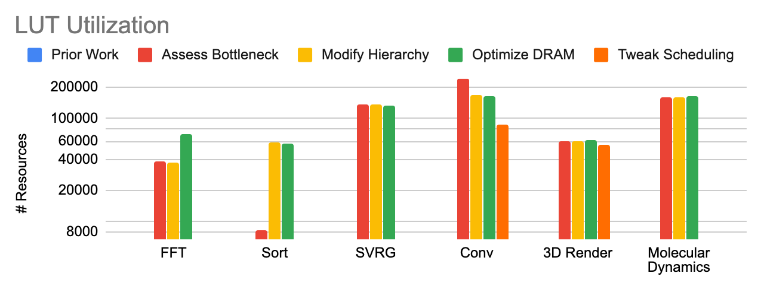
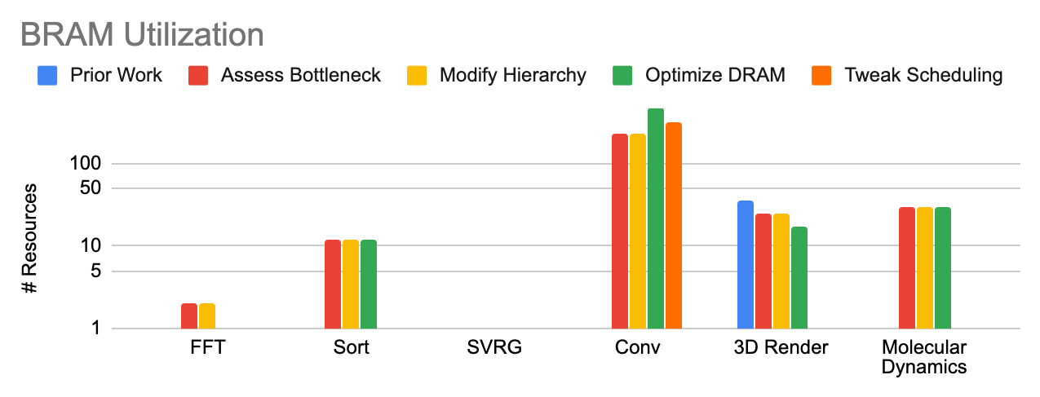
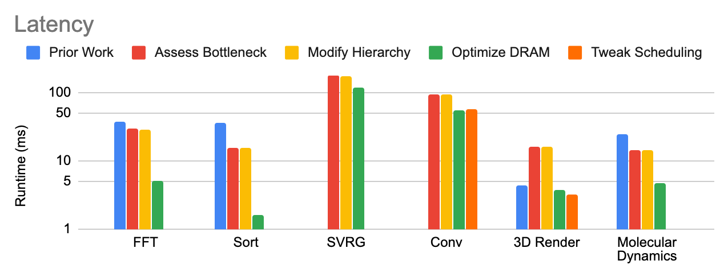
Results
More Optimization Steps
By following all steps, latency can improve significantly without harming resource utilization.
Lower is better Optimization
* Not all levels of optimization apply to all apps, and not all prior work reported utilization numbers

Slide 124
Key Contributions in This Talk
Problem: Expressing hardware at a high level results in sub-optimal designs
Solution: Design a language and compiler that provides
the right software abstractions
A performance debugging environment that lends itself to a set of optimization principles
Hardware-oriented optimizations for memory partitioning
Validation: Demonstrate effectiveness on a real-world problem

Slide 125
Memory Banking
A blackhole for FPGA resources

Slide 126


Memory Banking - Related Work
The compiler must implicitly chain BRAMs together to serve parallel accesses to memory
There are two formalisms for memory partitioning:
Hyperplane partitioning^{[7]} separation by parallel hyperplanes
Lattice partitioning^{[8]} separation by tessellated parallelepipeds
x
x
x
x
Bank 1
Fundamental
parallelepiped
x
x
x
x
Bank 2
Bank 0
Bank 3
Bank 1
Bank 0
Bank 0
Bank 2
Bank 2
Bank 1
Bank 3
Bank 3
Bank 0
[7] Y. Wang et al. “Theory and algorithm for generalized memory partitioning in high-level synthesis.” FPGA 2014
[8] A. Cilardo et al. “Improving Multibank Memory Access Parallelism with Lattice-Based Partitioning.” TACO 2015

Slide 127
Memory Banking
Spatial relies modified hyperplane partitioning, which captures all hyperplane geometries and a subset of lattice geometries (orthogonal parallelepipeds)

Slide 128
Memory Banking
How do you compute the bank (BA) and intra-bank offset (BO) of a a logical address, $\overset{⃗}{x}$, to a memory with dimensions $\overset{⃗}{D}$?
Bank 1
Logical address = <1,4>
x
Bank 2
Bank 0
Bank 3
Bank 1
Bank 0
Bank 2
BO = 2
Bank 3
Bank 0
BA = 0

Slide 129
Banking Equations
$$R=\overset{n}{\underset{i=0}{∑}}\left(⌊\frac{{\overset{⃗}{x}}_{i}}{{\overset{⃗}{P}}_{i}}⌋⋅\overset{n}{\underset{j=i+1}{∏}}⌈\frac{{\overset{⃗}{D}}_{j}}{{\overset{⃗}{P}}_{j}}⌉\right)$$
$$C=\overset{⃗}{x}⋅\overset{⃗}{α}modB$$
$$BO=R⋅B^{n}+C$$
$$BA=⌊\frac{\overset{⃗}{x}⋅\overset{⃗}{α}}{B}⌋modN$$
The compiler chooses parameters $\overset{⃗}{α}$, $B$, $N$, and $\overset{⃗}{P}$

Slide 130
Banking Equations
Problem: Expensive computations are pervasive in these equations…
$$R=\overset{n}{\underset{i=0}{∑}}\left(⌊\frac{{\overset{⃗}{x}}_{i}}{{\overset{⃗}{P}}_{i}}⌋⋅\overset{n}{\underset{j=i+1}{∏}}⌈\frac{{\overset{⃗}{D}}_{j}}{{\overset{⃗}{P}}_{j}}⌉\right)$$
$$C=\overset{⃗}{x}⋅\overset{⃗}{α}modB$$
$$BO=R⋅B^{n}+C$$
$$BA=⌊\frac{\overset{⃗}{x}⋅\overset{⃗}{α}}{B}⌋modN$$

Slide 131
Banking Equations
Problem: Expensive computations are pervasive in these equations…
$$R=\overset{n}{\underset{i=0}{∑}}\left(⌊\frac{{\overset{⃗}{x}}_{i}}{{\overset{⃗}{P}}_{i}}⌋⋅\overset{n}{\underset{j=i+1}{∏}}⌈\frac{{\overset{⃗}{D}}_{j}}{{\overset{⃗}{P}}_{j}}⌉\right)$$
$$C=\overset{⃗}{x}⋅\overset{⃗}{α}modB$$
$$BO=R⋅B^{n}+C$$
$$BA=⌊\frac{\overset{⃗}{x}⋅\overset{⃗}{α}}{B}⌋modN$$

Slide 132
Banking Equations
Problem: Expensive computations are pervasive in these equations…
$$R=\overset{n}{\underset{i=0}{∑}}\left(⌊\frac{{\overset{⃗}{x}}_{i}}{{\overset{⃗}{P}}_{i}}⌋⋅\overset{n}{\underset{j=i+1}{∏}}⌈\frac{{\overset{⃗}{D}}_{j}}{{\overset{⃗}{P}}_{j}}⌉\right)$$
$$C=\overset{⃗}{x}⋅\overset{⃗}{α}modB$$
$$BO=R⋅B^{n}+C$$
Variable
Constant
$$BA=⌊\frac{\overset{⃗}{x}⋅\overset{⃗}{α}}{B}⌋modN$$

Slide 133
Banking Equations
Solution: Choose constants that allow resource-saving transformations
Multiplication Decomposition (e.g. $12x=8x+4x=x≪3+x≪2$ )
Modulo and Division via Crandall’s Algorithm^{[9]} - Replace div/mod by Mersenne number with bitwise operations and addition
Mersenne number: $M=2^{n}-1$
[9] J. Chung et al. “Low-Weight Polynomial Form Integers for Efficient Modular Multiplication.” IEEE Transactions on Computers 2007

Slide 134
Banking Equations
Solution: Choose constants that allow resource-saving transformations
Multiplication Decomposition targets (up to second-order)
1 2 3 4 5 6 7 8 9 10 11 12 13 14 15 16 17 18 19 20 21
Crandall’s Algorithm targets (up to second-order)
1 2 3 4 5 6 7 8 9 10 11 12 13 14 15 16 17 18 19 20 21
This flexibility is very useful for choosing the best banking parameters

Slide 135
Experimental Setup
We compared resource utilization of this optimized analysis on 11 access patterns against two state-of-the-art SDH tools: Merlin Compiler^{[10]} and unmodified Spatial
Stencils^{[7]}:
deconv + deconv-ur
denoise
bicubic
sobel
jpeg motion lh + lv + c
Algorithms:
Smith-Waterman genetic alignment^{[11]}
sparse matrix-vector multiplication
stochastic gradient descent (SGD)^{[12]}
[10] https://www.falconcomputing.com/merlin-fpga-compiler/
[7] Y. Wang et al. “Theory and algorithm for generalized memory partitioning in high-level synthesis.” FPGA 2014
[11] Y. Turhakia et al. “Darwin: A Genomics Co-processor Provides up to 15,000X Acceleration on Long Read Assembly.” ASPLOS 2018
[12] C. De Sa. et al. “Understanding and optimizing asynchronous low-precision stochastic gradient descent.” ISCA 2017

Slide 136
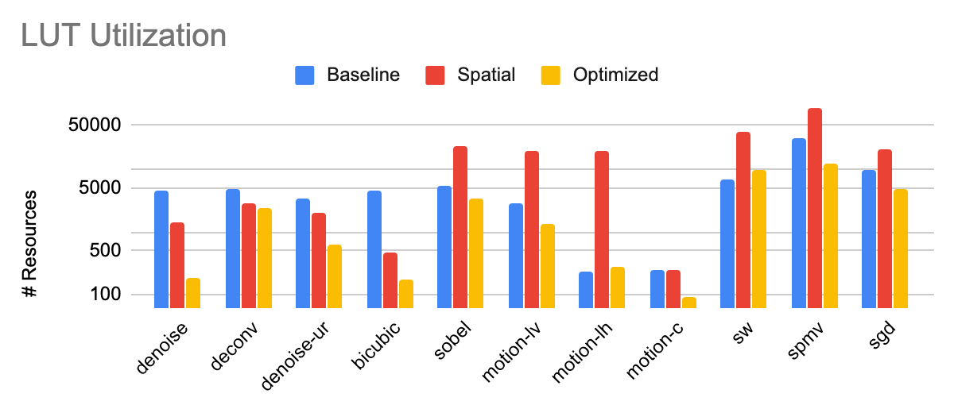
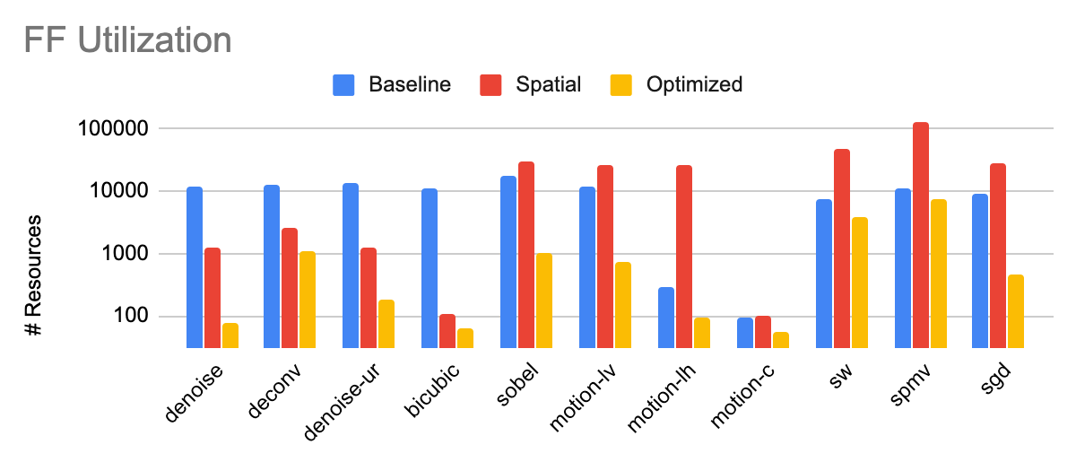
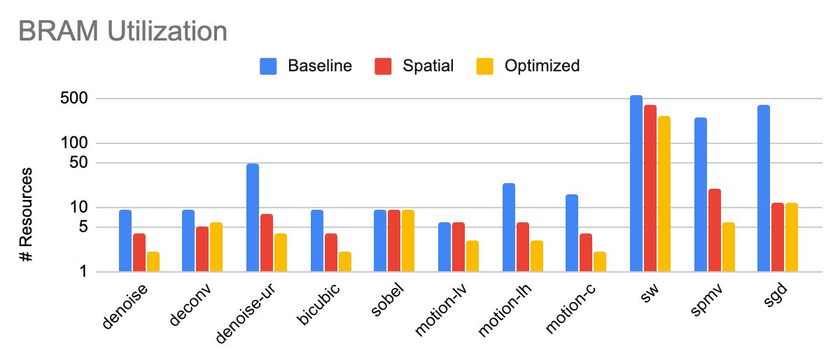
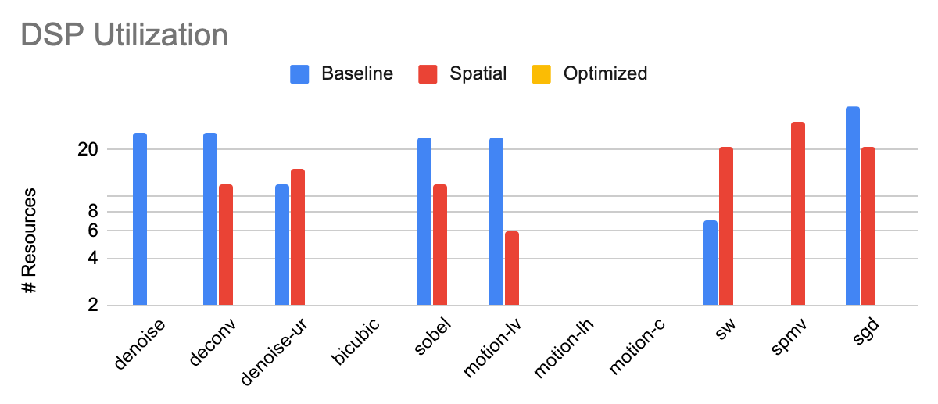
Results
Merlin and Spatial are usually a toss-up with regards to resource utilization, but the optimized banking analysis always outperforms both
Optimizer always cuts out DSPs

Slide 137
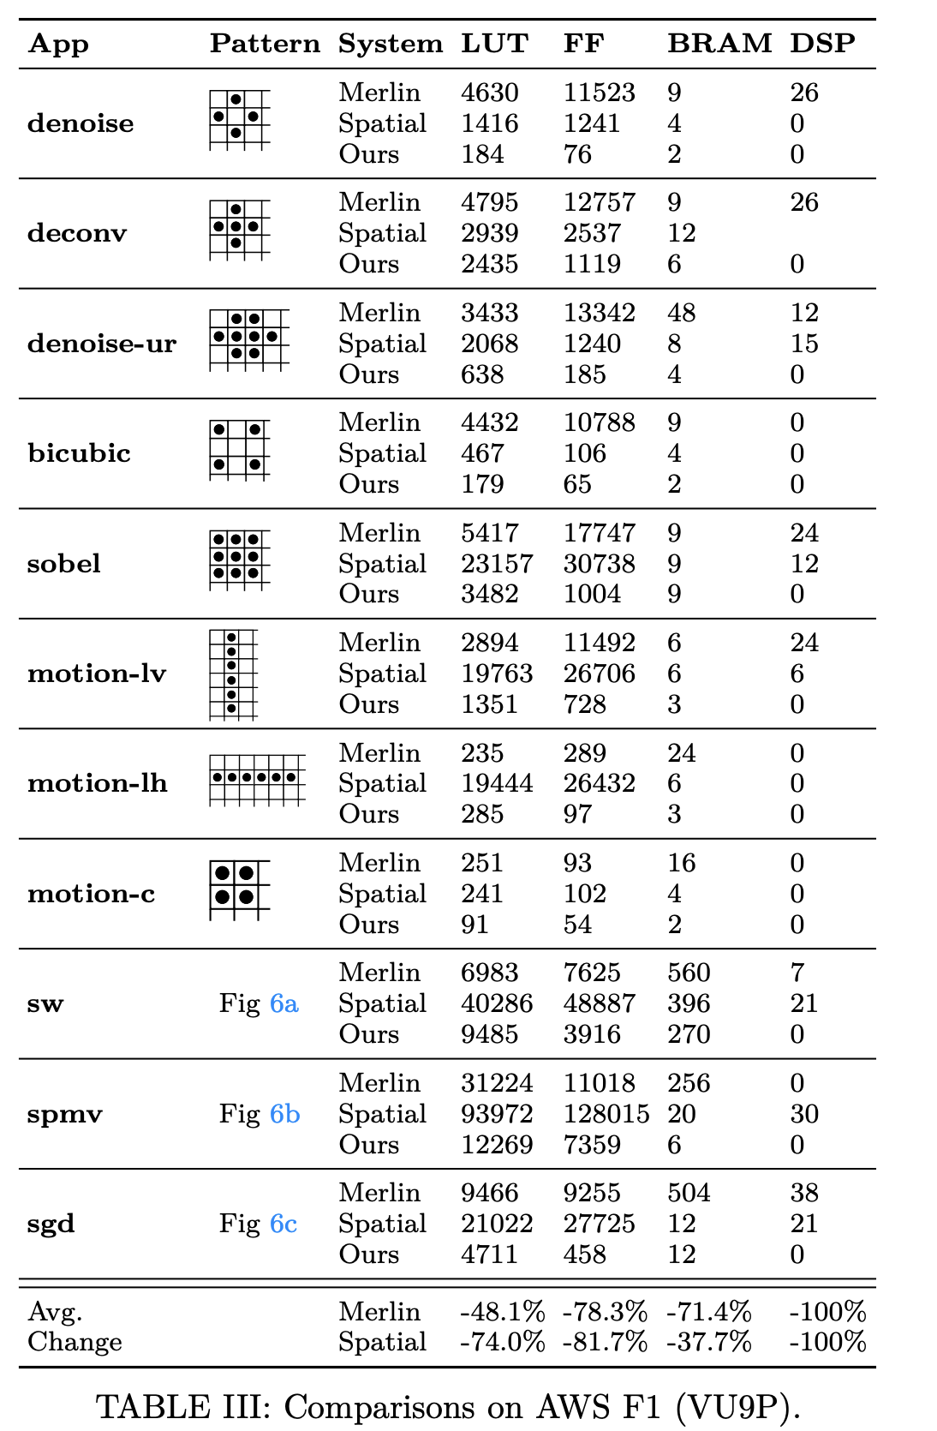
Results

Slide 138
What is Memory Banking?
Memory banking is a mapping from logical accesses to physical memory resources to prevent oversubscription of ports.
If the memory resources are single ported, we need four banks to satisfy these accesses.
Conceptually, each access gets dispatched to a different bank (color)
How do we do this mapping?

Slide 139
What is Memory Banking?
Two common methods of banking:
Hyperplane partitioning - Separate memory space into parallel hyperplanes, such that each one is a bank
Lattice partitioning - Separate memory space into parallelepipeds, such that each one contains each bank once
Insert pictures

Slide 140
Hyperplane Partitioning
Spatial relies on hyperplane partitioning. The “hyperplane geometry” is characterized by three parameters:
$\overset{⃗}{α}$ = Partitioning vector
B = Blocking factor
N = Number of banks
To compute a bank address (BA) given a logical reference to memory, $\overset{⃗}{x}$:
$$BA=⌊\frac{\overset{⃗}{x}⋅\overset{⃗}{α}}{B}⌋modN$$

Slide 141
Hyperplane Partitioning
In order to compute intra-bank offset (BO), one additional parameter must be introduced.
$\overset{⃗}{P}$ - Neighborhood polygon
Given memory with dimensions $\overset{⃗}{D}$, this is given by:
$$R=\overset{n}{\underset{i=0}{∑}}\left(⌊\frac{{\overset{⃗}{x}}_{i}}{{\overset{⃗}{P}}_{i}}⌋⋅\overset{n}{\underset{j=i+1}{∏}}⌈\frac{{\overset{⃗}{D}}_{j}}{{\overset{⃗}{P}}_{j}}⌉\right)$$
$$C=\overset{⃗}{x}⋅\overset{⃗}{α}modB$$
$$BO=R⋅B^{n}+C$$

Slide 142
Hyperplane Partitioning - Quick Example
Recall our example from before…
One valid geometry is N=6, B=1, $\overset{⃗}{α}$=<1>
Foreach(N by 3 par 2){ i =>
.. = arr[k+1] + arr[k+2]
}

Slide 143
Hyperplane Partitioning - Quick Example
Recall our example from before…
One valid geometry is N=6, B=1, $\overset{⃗}{α}$=<1>
Foreach(N by 3 par 2){ i =>
.. = arr[k+1] + arr[k+2]
}

Slide 144
Hyperplane Partitioning - Quick Example
Recall our example from before…
One valid geometry is N=6, B=1, $\overset{⃗}{α}$=<1>
Notice that each access only ever touches one color. In other words, the “switching factor” (SF) of each access in this case is 1.
SF is a convenient, first-order measure of how expensive the scheme may be, since larger SF means wider crossbars are required.
Foreach(N by 3 par 2){ i =>
.. = arr[k+1] + arr[k+2]
}

Slide 145
Hyperplane Partitioning - Quick Example
Recall our example from before…
One valid geometry is N=6, B=1, $\overset{⃗}{α}$=<1>
There is only possible neighborhood polygon, $\overset{⃗}{P}$=<6>
Foreach(N by 3 par 2){ i =>
.. = arr[k+1] + arr[k+2]
}
0
0
0
0
0
0
1
1
1
1
1
1
2
2
2
2
2
2
3
3
3
3
Pad

Slide 146
What is Memory Banking?
Spatial also supports multi-dimensional banking. Bank address is a vector (BA per dimension) but intra-bank offset is still a scalar.
Multi-dimensional banking is a subset of lattice partitioning, specifically for orthogonal parallelepipeds.
Solving for partitioning schemes has been well studied, but quickly finding efficient ones for FPGAs has not

Slide 147
Searching for a banking solution
Traditionally, solving for banking follows these steps:
Step 1) Find valid geometries (N, B, $\overset{⃗}{α}$)
Step 2) Find $\overset{⃗}{P}$ based on lexicographic ordering
Step 3) Choose solution that minimizes padding and bank fan-in

Slide 148
Searching for a banking solution
Spatial’s banking system has a few enhancements:
Step 1) Find valid geometries (N, B, $\overset{⃗}{α}$)
Step 2) Find $\overset{⃗}{P}$ based on lexicographic ordering all valid $\overset{⃗}{P}$
Step 3) Apply resource-saving optimizations to equation data flow paths
Step 4) Evaluate the cost (DSPs, BRAMs, and logic) of each solution
Step 5) Choose solution that minimizes padding and bank fan-in actual FPGA resources

Slide 149
Searching for a Banking Solution
These extra steps are critical in helping to bridge the gap between handwritten RTL and SDH
Plus, a compiler can search a much larger solution space for banking, and much more quickly than even the best RTL programmer.

Slide 150
Why is this a tricky problem?
Our toy example has a few valid geometries…
Foreach(N by 3 par 2){ i =>
.. = arr[k+1] + arr[k+2]
}
N=6, B=1, $\overset{⃗}{α}$=<1>
N=5, B=1, $\overset{⃗}{α}$=<1>
N=4, B=3, $\overset{⃗}{α}$=<2>

Slide 151
Why is this a tricky problem?
Our toy example has a few valid geometries…
Foreach(N by 3 par 2){ i =>
.. = arr[k+1] + arr[k+2]
}
N=6, B=1, $\overset{⃗}{α}$=<1>
N=5, B=1, $\overset{⃗}{α}$=<1>
N=4, B=3, $\overset{⃗}{α}$=<2>

Slide 152
Why is this a tricky problem?
Our toy example has a few valid geometries…
Foreach(N by 3 par 2){ i =>
.. = arr[k+1] + arr[k+2]
}
N=6, B=1, $\overset{⃗}{α}$=<1>
N=5, B=1, $\overset{⃗}{α}$=<1>
N=4, B=3, $\overset{⃗}{α}$=<2>

Slide 153
Why is this a tricky problem?
Evaluating SF for each solution…
Foreach(N by 3 par 2){ i =>
.. = arr[k+1] + arr[k+2]
}
N=6, B=1, $\overset{⃗}{α}$=<1>
SF = 1
N=5, B=1, $\overset{⃗}{α}$=<1>
SF = 5
N=4, B=3, $\overset{⃗}{α}$=<2>
SF = 1

Slide 154
Why is this a tricky problem?
Evaluating SF for each solution…
Foreach(N by 3 par 2){ i =>
.. = arr[k+1] + arr[k+2]
}
N=6, B=1, $\overset{⃗}{α}$=<1>
SF = 1
N=5, B=1, $\overset{⃗}{α}$=<1>
SF = 5
N=4, B=3, $\overset{⃗}{α}$=<2>
SF = 1

Slide 155
Why is this a tricky problem?
Each scheme only has one valid choice for $\overset{⃗}{P}$
Foreach(N by 3 par 2){ i =>
.. = arr[k+1] + arr[k+2]
}
N=6, B=1, $\overset{⃗}{α}$=<1>, $\overset{⃗}{P}$=<6>
Pad
N=5, B=1, $\overset{⃗}{α}$=<1>, $\overset{⃗}{P}$=<5>
Pad
N=4, B=3, $\overset{⃗}{α}$=<2>, $\overset{⃗}{P}$=<6>
Pad
pad

Slide 156
Why is this a tricky problem?
Evaluating padded volume…
Foreach(N by 3 par 2){ i =>
.. = arr[k+1] + arr[k+2]
}
N=6, B=1, $\overset{⃗}{α}$=<1>, $\overset{⃗}{P}$=<6>
V = 24
Pad
N=5, B=1, $\overset{⃗}{α}$=<1>, $\overset{⃗}{P}$=<5>
V = 25
Pad
N=4, B=3, $\overset{⃗}{α}$=<2>, $\overset{⃗}{P}$=<6>
V = 32
Pad

Slide 157
Why is this a tricky problem?
Evaluating padded volume…
Foreach(N by 3 par 2){ i =>
.. = arr[k+1] + arr[k+2]
}
N=6, B=1, $\overset{⃗}{α}$=<1>, $\overset{⃗}{P}$=<6>
V = 24
Pad
N=5, B=1, $\overset{⃗}{α}$=<1>, $\overset{⃗}{P}$=<5>
V = 25
Pad
N=4, B=3, $\overset{⃗}{α}$=<2>, $\overset{⃗}{P}$=<6>
V = 32
Pad
pad

Slide 158
Why is this a tricky problem?
But it is the amount of BRAMs that actually counts on FPGA
Foreach(N by 3 par 2){ i =>
.. = arr[k+1] + arr[k+2]
}
N=6, B=1, $\overset{⃗}{α}$=<1>, $\overset{⃗}{P}$=<6>
V = 24
Pad
N=5, B=1, $\overset{⃗}{α}$=<1>, $\overset{⃗}{P}$=<5>
V = 25
Pad
N=4, B=3, $\overset{⃗}{α}$=<2>, $\overset{⃗}{P}$=<6>
V = 32
Pad
pad

Slide 159
Why is this a tricky problem?
Suppose each BRAM has 7 words…
Foreach(N by 3 par 2){ i =>
.. = arr[k+1] + arr[k+2]
}
N=6, B=1, $\overset{⃗}{α}$=<1>, $\overset{⃗}{P}$=<6>
#BRAM = 6
Pad
N=5, B=1, $\overset{⃗}{α}$=<1>, $\overset{⃗}{P}$=<5>
#BRAM = 5
Pad
N=4, B=3, $\overset{⃗}{α}$=<2>, $\overset{⃗}{P}$=<6>
#BRAM = 8
Pad

Slide 160
Why is this a tricky problem?
Suppose each BRAM has 7 words…
Foreach(N by 3 par 2){ i =>
.. = arr[k+1] + arr[k+2]
}
N=6, B=1, $\overset{⃗}{α}$=<1>, $\overset{⃗}{P}$=<6>
#BRAM = 6
Pad
N=5, B=1, $\overset{⃗}{α}$=<1>, $\overset{⃗}{P}$=<5>
#BRAM = 5
Pad
N=4, B=3, $\overset{⃗}{α}$=<2>, $\overset{⃗}{P}$=<6>
#BRAM = 8
Pad

Slide 161
Why is this a tricky problem?
For minimizing SF, options 1 and 3 are best. For minimizing #BRAMs, option 2 is best.
Foreach(N by 3 par 2){ i =>
.. = arr[k+1] + arr[k+2]
}
N=6, B=1, $\overset{⃗}{α}$=<1>, $\overset{⃗}{P}$=<6>
Pad
N=5, B=1, $\overset{⃗}{α}$=<1>, $\overset{⃗}{P}$=<5>
Pad
N=4, B=3, $\overset{⃗}{α}$=<2>, $\overset{⃗}{P}$=<6>
Pad

Slide 162
Why is this a tricky problem?
So options 1 and 3 are best for minimizing SF, but option 2 is best for minimizing BRAMs…
Foreach(N by 3 par 2){ i =>
.. = arr[k+1] + arr[k+2]
}
N=6, B=1, $\overset{⃗}{α}$=<1>, $\overset{⃗}{P}$=<6>
Pad
N=5, B=1, $\overset{⃗}{α}$=<1>, $\overset{⃗}{P}$=<5>
Pad
N=4, B=3, $\overset{⃗}{α}$=<2>, $\overset{⃗}{P}$=<6>
Pad

Slide 163
Why is this a tricky problem?
Let’s consider compute complexity next
The expensive operations in these equations are
$$R=\overset{n}{\underset{i=0}{∑}}\left(⌊\frac{{\overset{⃗}{x}}_{i}}{{\overset{⃗}{P}}_{i}}⌋⋅\overset{n}{\underset{j=i+1}{∏}}⌈\frac{{\overset{⃗}{D}}_{j}}{{\overset{⃗}{P}}_{j}}⌉\right)$$
$$C=\overset{⃗}{x}⋅\overset{⃗}{α}modB$$
$$BO=R⋅B^{n}+C$$
$$BA=⌊\frac{\overset{⃗}{x}⋅\overset{⃗}{α}}{B}⌋modN$$

Slide 164
Why is this a tricky problem?
Let’s consider compute complexity next
The expensive operations in these equations are modulo
$$R=\overset{n}{\underset{i=0}{∑}}\left(⌊\frac{{\overset{⃗}{x}}_{i}}{{\overset{⃗}{P}}_{i}}⌋⋅\overset{n}{\underset{j=i+1}{∏}}⌈\frac{{\overset{⃗}{D}}_{j}}{{\overset{⃗}{P}}_{j}}⌉\right)$$
$$C=\overset{⃗}{x}⋅\overset{⃗}{α}modB$$
$$BO=R⋅B^{n}+C$$
$$BA=⌊\frac{\overset{⃗}{x}⋅\overset{⃗}{α}}{B}⌋modN$$

Slide 165
Why is this a tricky problem?
Let’s consider compute complexity next
The expensive operations in these equations are modulo, division
$$R=\overset{n}{\underset{i=0}{∑}}\left(⌊\frac{{\overset{⃗}{x}}_{i}}{{\overset{⃗}{P}}_{i}}⌋⋅\overset{n}{\underset{j=i+1}{∏}}⌈\frac{{\overset{⃗}{D}}_{j}}{{\overset{⃗}{P}}_{j}}⌉\right)$$
$$C=\overset{⃗}{x}⋅\overset{⃗}{α}modB$$
$$BO=R⋅B^{n}+C$$
$$BA=⌊\frac{\overset{⃗}{x}⋅\overset{⃗}{α}}{B}⌋modN$$

Slide 166
Why is this a tricky problem?
Let’s consider compute complexity next
The expensive operations in these equations are modulo, division, and multiplication
$$R=\overset{n}{\underset{i=0}{∑}}\left(⌊\frac{{\overset{⃗}{x}}_{i}}{{\overset{⃗}{P}}_{i}}⌋⋅\overset{n}{\underset{j=i+1}{∏}}⌈\frac{{\overset{⃗}{D}}_{j}}{{\overset{⃗}{P}}_{j}}⌉\right)$$
$$C=\overset{⃗}{x}⋅\overset{⃗}{α}modB$$
$$BO=R⋅B^{n}+C$$
$$BA=⌊\frac{\overset{⃗}{x}⋅\overset{⃗}{α}}{B}⌋modN$$

Slide 167
Why is this a tricky problem?
Let’s consider compute complexity next
The expensive operations in these equations are modulo, division, and multiplication
$$R=\overset{n}{\underset{i=0}{∑}}\left(⌊\frac{{\overset{⃗}{x}}_{i}}{{\overset{⃗}{P}}_{i}}⌋⋅\overset{n}{\underset{j=i+1}{∏}}⌈\frac{{\overset{⃗}{D}}_{j}}{{\overset{⃗}{P}}_{j}}⌉\right)$$
$$C=\overset{⃗}{x}⋅\overset{⃗}{α}modB$$
$$BO=R⋅B^{n}+C$$
Variable
Constant
$$BA=⌊\frac{\overset{⃗}{x}⋅\overset{⃗}{α}}{B}⌋modN$$

Slide 168
Why is this a tricky problem?
If one of the operands is a power-of-2, there is an obvious rewrite rule that makes the operation essentially free on FPGA
Division -> bit-shift right
Multiplication -> bit-shift left
Modulo -> bitwise-and
The “compute complexity” of each solution is what consumes DSPs and logic resources. The actual amount of DSPs and logic depends on the specific vendor IP used to implement it, as well as how the synthesis tool decides to implement the adjacent operations in the circuit

Slide 169
Why is this a tricky problem?
Let’s revisit our toy example through the lens of compute complexity
Foreach(N by 3 par 2){ i =>
.. = arr[k+1] + arr[k+2]
}
N=6, B=1, $\overset{⃗}{α}$=<1>, $\overset{⃗}{P}$=<6>
#mod = 1
#div = 1
#mul = 0
Pad
N=5, B=1, $\overset{⃗}{α}$=<1>, $\overset{⃗}{P}$=<5>
#mod = 1
#div = 1
#mul = 1
Pad
#mod = 1
#div = 2
#mul = 1
N=4, B=3, $\overset{⃗}{α}$=<2>, $\overset{⃗}{P}$=<6>
Pad

Slide 170
Why is this a tricky problem?
Compute complexity
Foreach(N by 3 par 2){ i =>
.. = arr[k+1] + arr[k+2]
}
N=6, B=1, $\overset{⃗}{α}$=<1>, $\overset{⃗}{P}$=<6>
#mod = 1
#div = 1
#mul = 0
Pad
N=5, B=1, $\overset{⃗}{α}$=<1>, $\overset{⃗}{P}$=<5>
#mod = 1
#div = 1
#mul = 1
Pad
#mod = 1
#div = 2
#mul = 1
N=4, B=3, $\overset{⃗}{α}$=<2>, $\overset{⃗}{P}$=<6>
Pad

Slide 171
Bottom Line
The resources we actually care about are BRAMs, DSPs, and logic.
The relative scarcity of each is application-specific.
Different banking decisions have different implications on these resources.
So how do we actually choose the best one?
Accurate cost modeling of IR nodes

Slide 172
Cost Modeling
Our system uses an gradient boosting trees to estimate the cost of each node in Spatial IR
TODO: Introduce xgboost

Slide 173
Cost Modeling
Using this model, we can find the optimal banking scheme for the application
Compute the utilization of each resource (BRAM, DSP, logic) for the application as a whole.
Use the relative scarcity of each resource to determine a penalization for each resource
Compute the utilization of each resource for each banking scheme, and use the relative scarcity of each resource to convert to a mono-objective

Slide 174
But wait! There’s more…
There is actually more we can do to help reduce the cost of each banking scheme
Multiplication, division, and modulo by many constants can be expressed as a series of bit-wise operations and addition.

Slide 175
Resource-Saving Transformations - Mult
Decomposition of multiplication:
Multiplication can be reduced to bit-shift left and addition if it is in the form $x⋅c$, where
$$c=\underset{0≤k<R}{∑}S(k)2^{n_{k}}$$
$S(k)∈\{1,-1\}$ and $R$ is the radius of the operation (set to 2 by default)

Slide 176
Resource-Saving Transformations - Modulo
Crandall’s Algorithm
Modulo can be reduced to bit-shift right, bitwise-and, addition, and a priority mux if it is in the form of $xmodM$, where $M$ is a “Mersenne” number in the form
$$M=2^{n}-1$$
$$n∈Z^{+}$$
TODO: make slide more readable

Slide 177
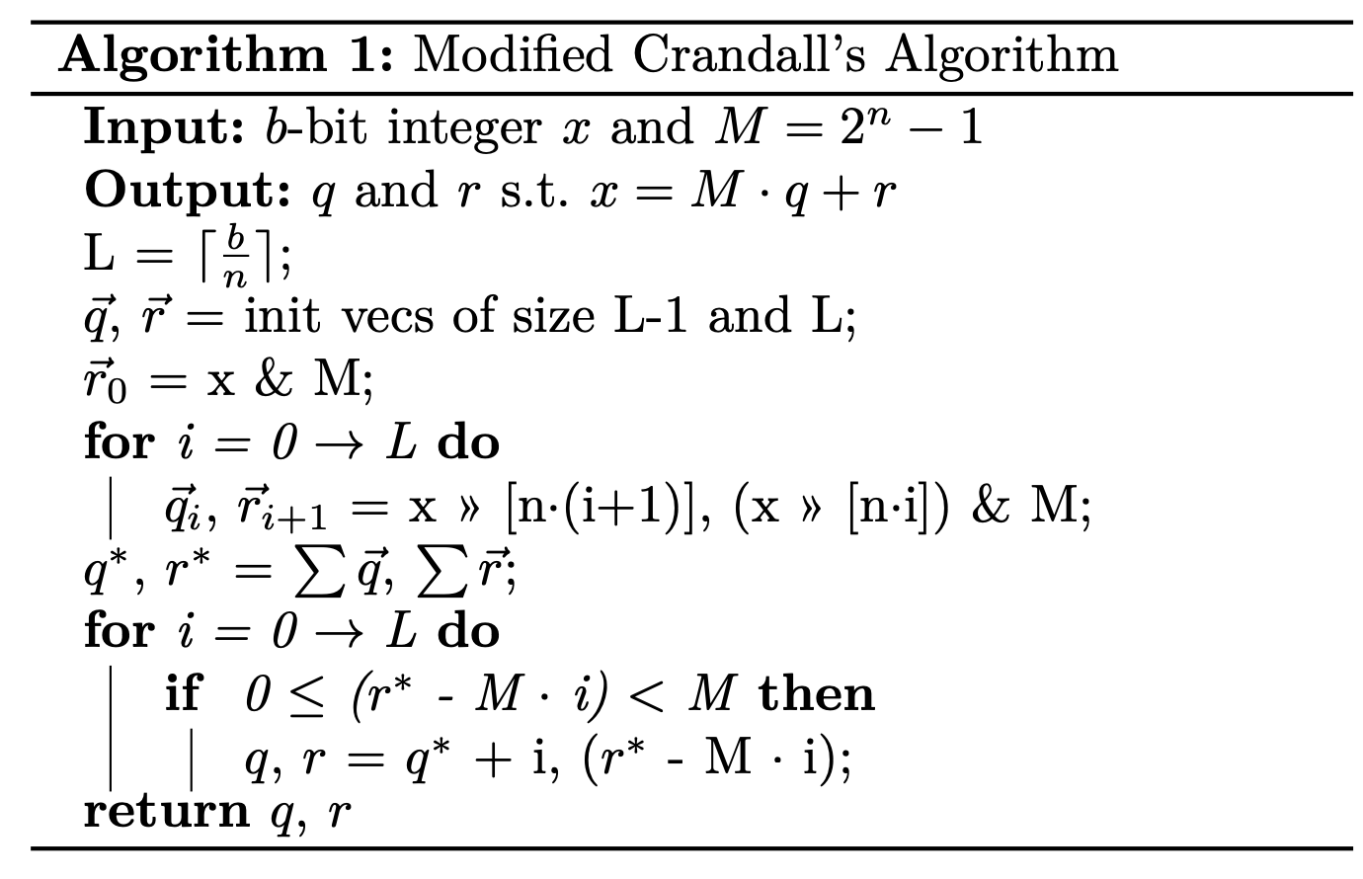
TODO: Show full Crandall algorithm?

Slide 178
Resource-Saving Transformations - Division
Modified Crandall’s Algorithm
Division can also be reduced to bit-shift right, bitwise-and, addition, and a priority mux if the denominator is a Mersenne number by following Crandall’s Algorithm and maintaining intermediate results.
TODO: make slide more readable

Slide 179
Resource-Saving Transformations - Modulo
Crandall’s Algorithm -> Brute Force Remainder
By adding a priority mux of width $R$ to the result of modulo by a Mersenne number, it is possible to reduce more operations in the form
$xmodM_{2}=\left(xmodM\right)modM2$
$k⋅M_{2}=M$, $k<R$
The inner mod uses Crandall’s algorithm, while the outer mod is a priority mux that brute-forces the remainder on a number that is guaranteed to be smaller than M
TODO: make slide more readable

Slide 180
Resource-Saving Transformations
How many integers result in arithmetic that can be broken down using these three rules? For non-powers-of-2 between 1 and 65, we can scrub
25 integers using multiplication rewrites under radius 2
5 integers using div/mod rewrites (Crandall’s algorithm)
5 additional integers using second-order Mersenne mod rewrites
However, asking “how many” integers we can rewrite is not actually a good question. We can steer the search towards schemes that use these integers from the start, and are typically successful in finding valid schemes.
TODO: make slide more readable

Slide 181
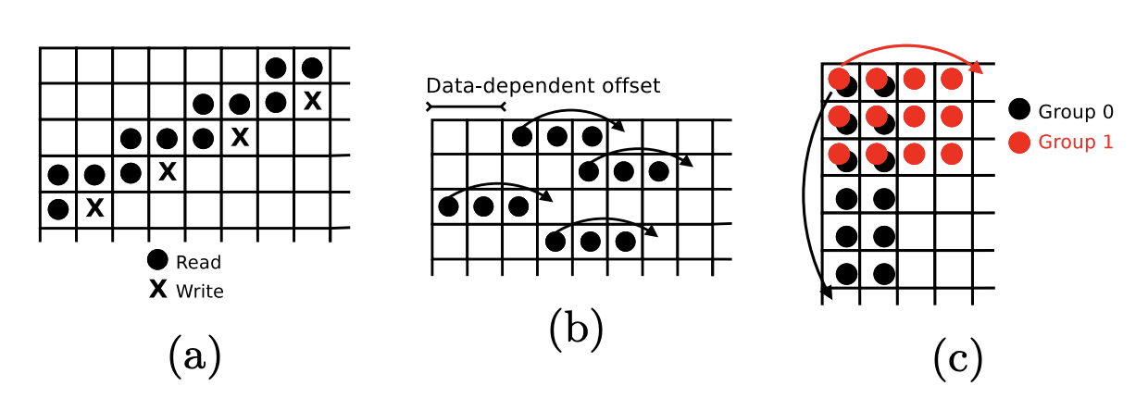
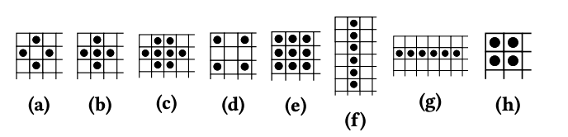
Memory Banking Results
We tested on a variety of stencil patterns and strided patterns on a Virtex 7 and AWS F1 instance (VU9P)
TODO: make slide more readable

Slide 182
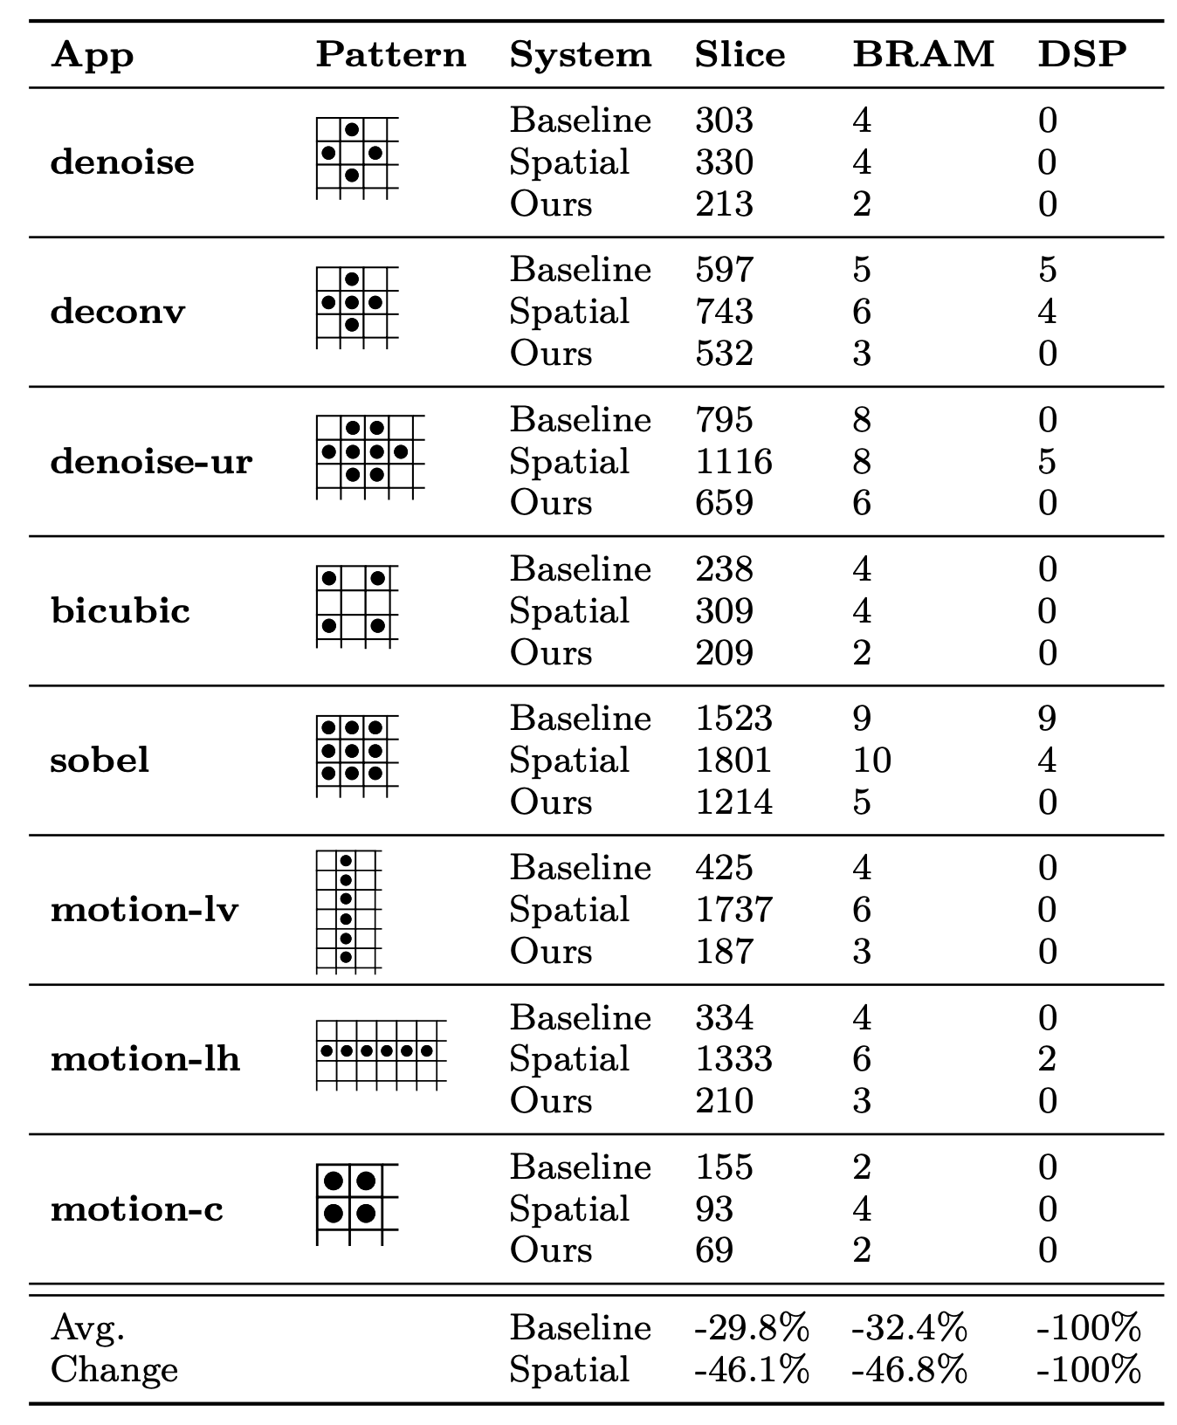
Memory Banking Results

Slide 183
Key Contributions in This Talk
Problem: Expressing hardware at a high level results in sub-optimal designs
Solution: Design a language and compiler that provides
the right software abstractions
A performance debugging environment that lends itself to a set of optimization principles
Hardware-oriented optimizations for memory partitioning
Validation: Demonstrate effectiveness on a real-world problem

Slide 184
How Well Does Spatial Work in the Real World?
XFEL Pulse Alignment on LCLS-II

Slide 185
Background
SLAC National Accelerator Laboratory is a Dept. of Energy research lab that uses synchrotron radiation and free-electron lasers for fundamental science
Annual budget: $383M
Annual users: 2,700
The newest system is LCLS-II (Linac Coherent Light Source)
Provides scientists with much higher brightness x-rays and faster repetition rates (up to 10,000x LCLS-I)
The “timetool” is a critical diagnostic component for optical/x-ray pulse synchronization

Slide 186
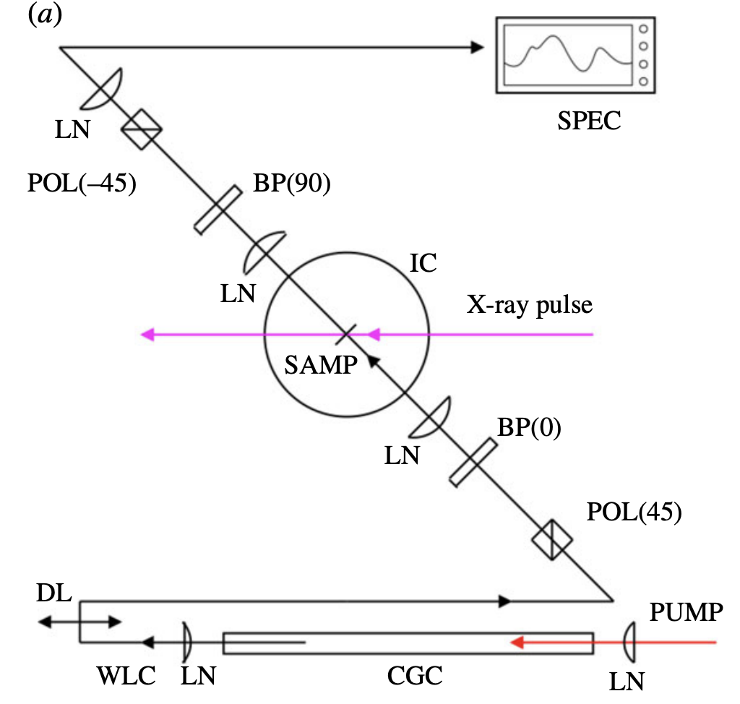
The Task
Predict arrival time of x-ray pulse by measuring its effect on chirped white light^{[13]}
Polarize to -45° (filter for any mismatched re-alignment)
Frequency
FPGA
Shear 90° component (“re-align”)
FPGA
Shear 0° component (spread freq. over time)
POL: Polarizer
LN: Lense
CGC: Continuum generation cell
BP: Birefringent plate
WLC: White light continuum
Interfere with x-ray via diamond sample
Position
Polarize to 45°
Euresys CXP12 (XKCU035 @ 250MHz)
Generate white light
[13] R. Coffee et al. “Development of ultrafast capabilities for X-ray free-electron lasers at the linac coherent light source.” Philosophical Transactions of the Royal Society

Slide 187
The Task
In order to solve this task on the available FPGAs in real-time, we need a way to quickly and easily
Design various ML networks
Explore the design space of each network
Converge on the best solution (minimize latency and mean-absolute error) that satisfies the FPGA’s resource budget

Slide 188
Available Resources
4x - Xilinx Kintex Ultrascale (XCKU350) - on-board Euresys Coaxlink Quad CXP-12
Each board reads 4 channels in parallel
2x - Xilinx Kintex Ultrascale (KCU1500) - downstream, connected via PCIe

Slide 189
Required Compute Blocks
Pre-filtering - 1D convolution to preprocess lines of the sensor independently
Quality gating - Reject samples with nonsensical data
Line inference - Infer an arrival time for each line independently
Aggregation - Coalesce line inferences and predict overall arrival time and confidence

Slide 190
Line Inference
Four classes of algorithms can handle regression at line-rate
Polynomial Fit
Multi-Layer Perceptron (MLP)
Heavy compute at inference time
Lattice Regression
Medium compute at inference time
eXtreme Gradient BOOSTing trees
Little compute at inference time

Slide 191
The Solution
Determine which ML model performs the best while achieving sufficiently-low latency and resource utilization (on a shared Xilinx Kintex Ultrascale XCKU035)

Slide 192
The Solution
Spatial makes this easy*
Assessed four classes of inference networks
Polynomial fit
Gradient Boosting Trees (XGBoost)^{[14]}
Lattice Regression (with Hypercube interpolation)^{[15]}
Multilayer Perceptron (MLP)^{[16]}
“Heavier” computation at inference time
But is the improvement in ML metrics worth it?
Measured in programming time/effort (hours or days) and LoC (~50 per kernel).
[14] T. Chen et al. “XGBoost: A Scalable Tree Boosting System.” arXiv Preprint 2016
[15] E. Garcia. “Lattice Regression.” NIPS 2009
[16] F. Murtagh. “Multilayer perceptrons for classification and regression” Neurocomputing 1991[

Slide 193
Results
Red cell indicates “limiting” resource if you scale up the model’s hyper parameters. Only best configuration per kernel is shown
Lattice and MLP require too much compute to fit the data
Polyfit cannot fit the data well
 | Runtime Performance | Resource Utilization |  |  |  | ML Performance
Network Category | latency (ns) | LUT | FFs | DSP | BRAM | MAE (fs)
Baseline (FFT-based CPU)^{[13]} | ~1000 | - | - | - | - | ~5
Polyfit (3rd order) | 104 | 832 | 1340 | 60 | 0 | 19.78
XGBoost (depth 7 x 128 trees) | 60 | 155941 | 77107 | 0 | 0 | 1.39
Lattice (calib 4, edged 5) | 92 | 6215 | 9425 | 191 | 0 | 4.01
MLP (8x16x4x1) | 208 | 17428 | 34531 | 1134 | 0 | 2.91
XGBoost is LUT/routing intensive, but overall the best architecture for the task
[13] R. Coffee et al. “Development of ultrafast capabilities for X-ray free-electron lasers at the linac coherent light source.” Philosophical Transactions of the Royal Society

Slide 194
Conclusion
The right software abstractions and performance debugging environment allows the programmer to take a principled approach to hardware optimization
Memory partitioning can be be optimized by incorporating automatic, targeted resource-saving optimizations
Domain experts can rapidly innovate and generate optimal hardware for complex algorithms

Slide 195

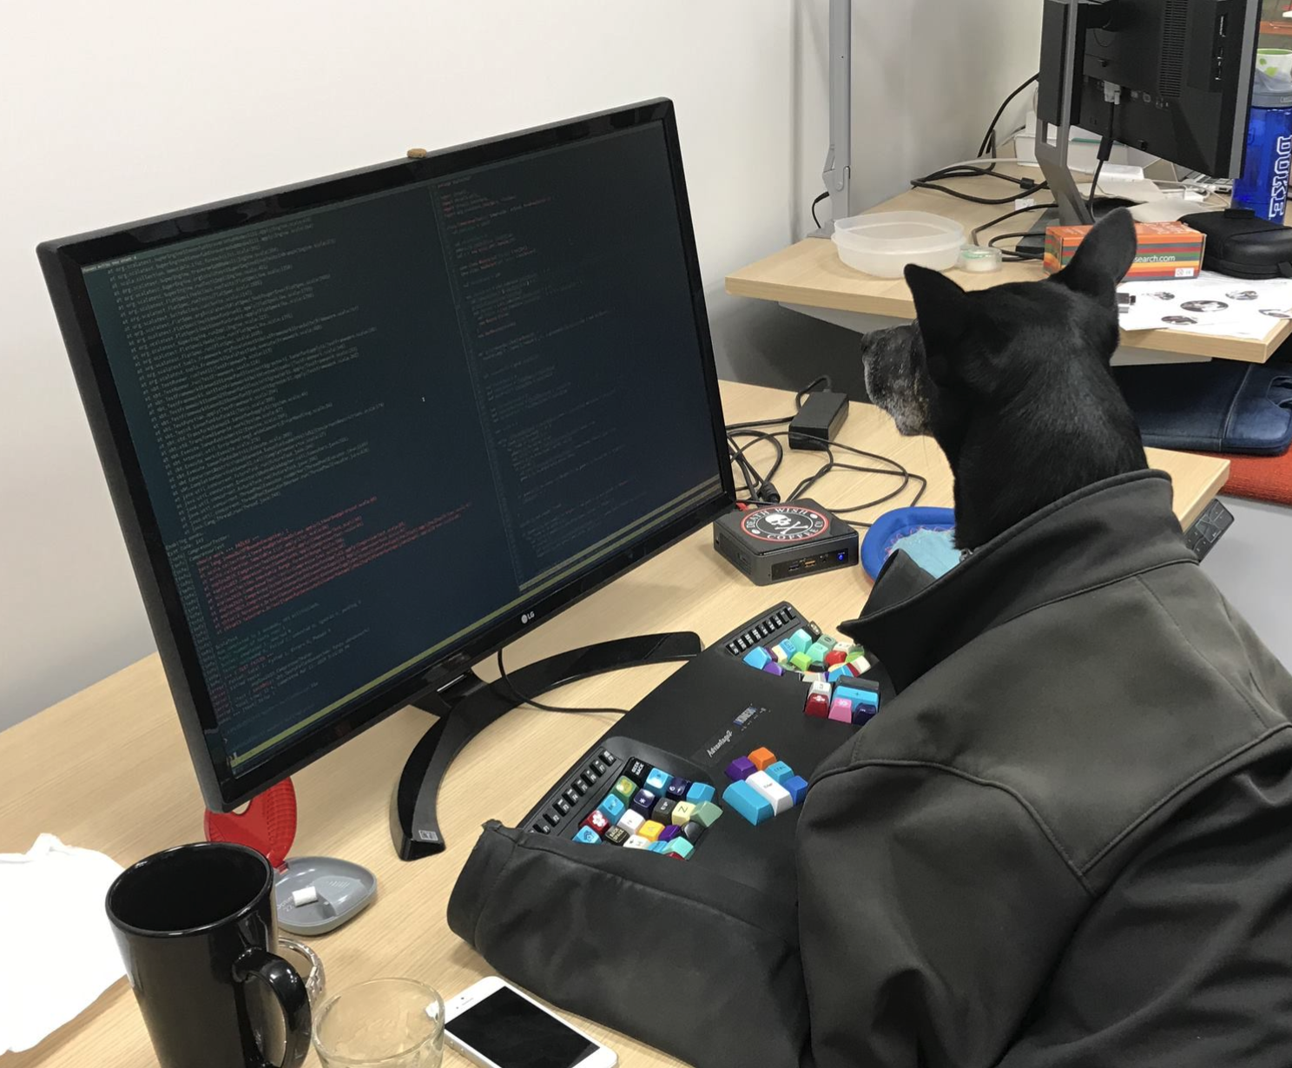
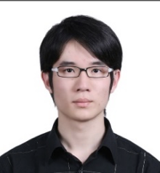
Acknowledgements
Kunle Olukotun
Christopher Ré
Kayvon Fatahalian
Ryan Coffee
Mykel Kochenderfer
Raghu Prabhakar
David
Koeplinger
Alex Rucker
Matt Vilim
Tian Zhao
Nathan Zhang
Yaqi Zhang
Tushar Swamy
Stefan Shadjis
Olivia Hsu, Rekha Singhal, Muhammad Shahbaz, Ardavan Pedram, Luigi Nardi, and everyone from Kunle’s group!
Dan Moreau, Andrea Brand-Sanchez, and all DAWN members!
Friends and Family and Elyse!

Slide 196
Thank You!

